Slide 1
Age of Exploration Week 2-1
Global 2
Ms. Lyons

Slide 2
Reasons for European Exploration
Wanted Asian spices
Needed direct route, so they didn’t have to trade for them
Less expensive

Slide 3
1400’s
Portugal & Spain explored first!
WHY?
They had technology & resources.
Gunpowder, navigation equipment, maps

Slide 4
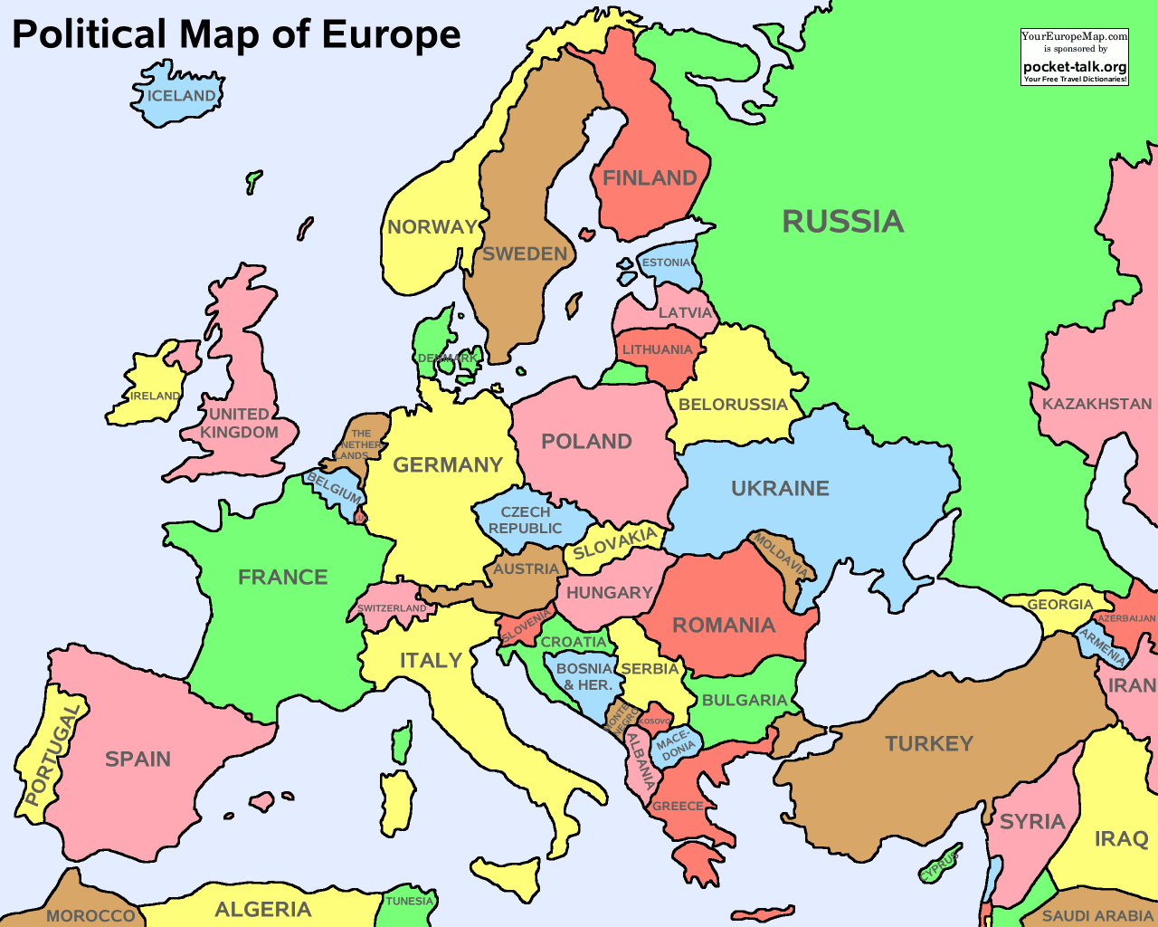

Slide 5
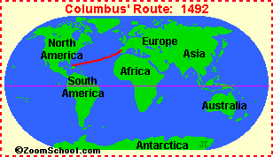
Where did they go?
Latin America

Slide 6
Conquistadors in the Americas
Christopher Columbus (1492)
Went west to get to India & reached Caribbean
Hernan Cortes (1521)
Conquered Aztecs
Francisco Pizarro (1532)
Conquered Incas
Notes:
Conquistador: one that conquers (specifically referring to Spanish conquering Americas in 1500’s)

Slide 7
How did they conquer the natives?
Better weapons
Guns, horses
Allied with groups of natives
Controlled by Aztecs/Incas
Diseases
Lost faith in their gods
Europeans cut off the natives’ hands if they did not give them gold
Bled to death

Slide 8
DAY 2
Wednesday

Slide 9
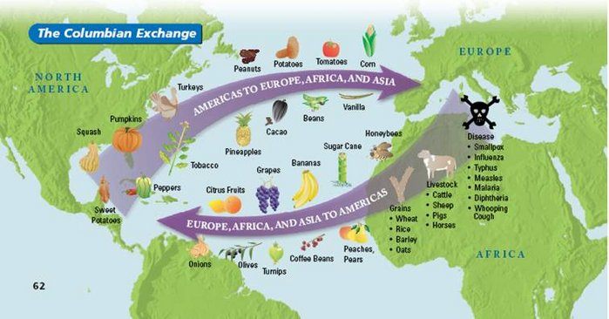
Columbian Exchange
Started a global trading system
Cultural Diffusion!
Notes:
Corn, potatoes → Americas to Europe
Bananas, rice → Europe to Americas
Goats, chickens → Africa & Asia to Americas
DISEASES → Americas

Slide 10
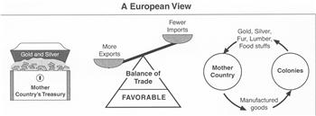
Mercantilism
ECONOMIC policy
Notes:
European countries get natural resources from colonies
Make products
Sell back to colonies to make money

Slide 11
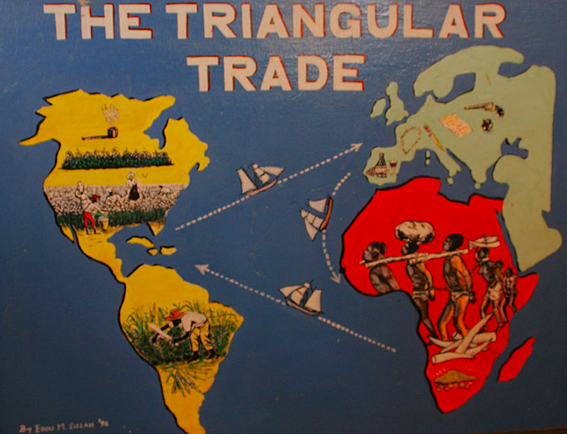
Triangular Trade
1500’s-1800’s: African slaves brought to Americas to work on plantations
Triangle between Africa, Americas, Europe
Middle Passage: the trip from Africa to the Americas on slave ships
Millions died from disease, mistreatment, or suicide

Slide 12
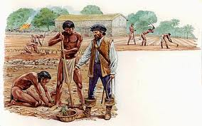
Encomienda System
Conquistadors made natives work for them
Created social classes
Europeans were “best”

Slide 13
Encomienda System
Peninsulares (born in Spain)
Creoles (European descent)
Mestizos (mix: Native & European)
& Mulattoes (mix: African & European)
Native Americans & Africans

Slide 14
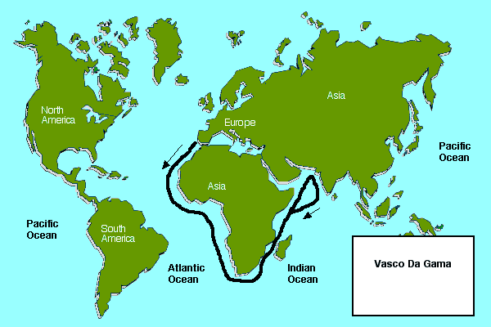
Explorers on Routes to Asia
Bartholomew Dias
Cape of Good Hope
Vasco de Gama
Cape of Good Hope
Came back with Asian spices

