Slide 1
Crusades
Global 2
Ms. Lyons

Slide 2
Religion = HUGE.
Only thing that unified Europeans in the Middle Ages = Catholic Church.
Serfs, knights, lords came together to fight for the Catholic Church when they decided to retake the Holy Land (sacred land for Islam, Judaism, and Christianity).
Notes:
Serfs & knights were not truly loyal to their noble/lord. If they could get a better deal somewhere else, they would take it

Slide 3
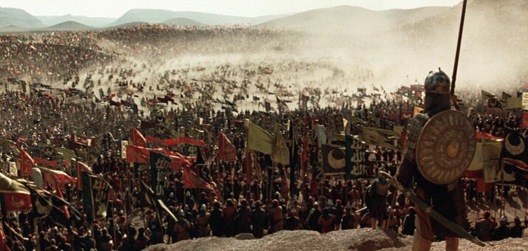
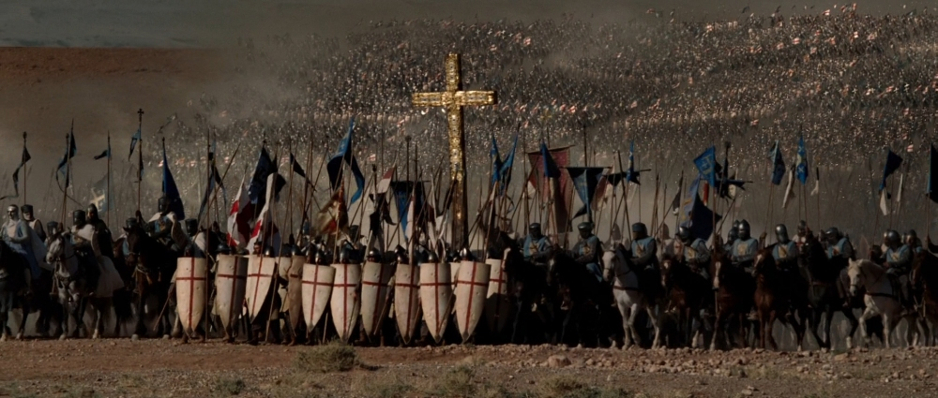
Holy Land
Christians
Muslims
Jesus (son of God) was born there, died on the cross, & rose to Heaven
Church of the Resurrection
Muhammad (prophet) was taken to the “Farthest Mosque,” prayed there, then rose to Heaven
Dome of the Rock
Notes:
Church of the Resurrection – where Jesus is buried –

Slide 4
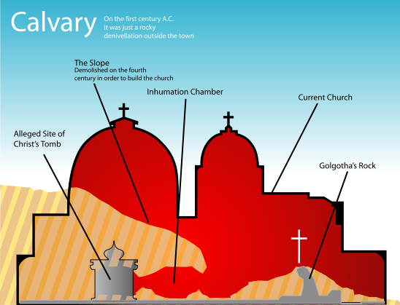

Slide 5
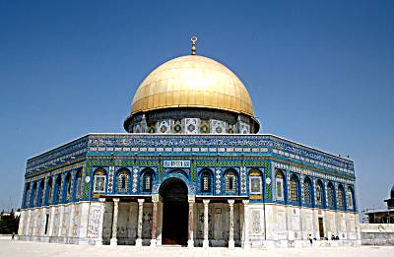
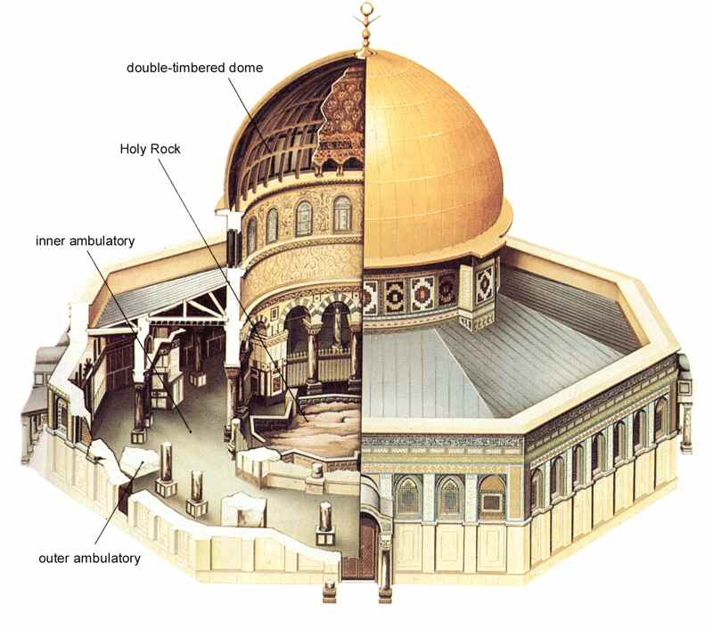
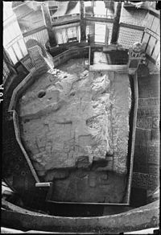
Notes:
“Foundation Stone” - Muslims used to face it while praying (now they face Mecca) & where Muhammad went up to Heaven
Jewish people still face this rock with praying

Slide 6
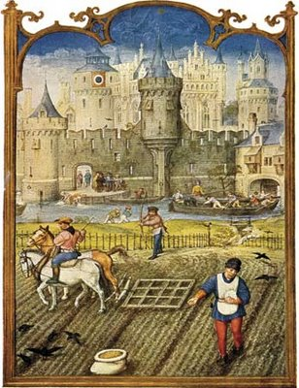
What motivated the different groups to join the Crusades?
Pope (Urban II) wanted more power
Nobles wanted money & land
Serfs wanted to escape feudalism (freedom!)
All Christians were told their sins would be forgiven if they fought for God
Everyone wanted a chance for travel & excitement

Slide 7
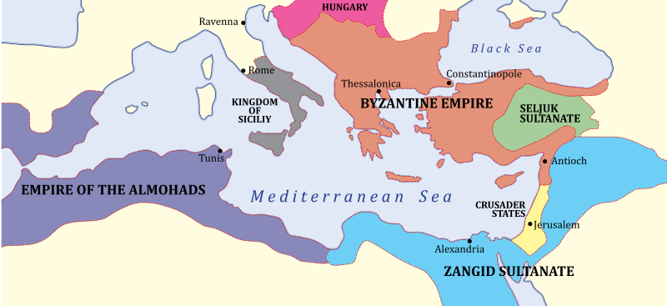
Many Crusades: 1100-1300
Catholic Church fought with Muslims for control of the Holy Land for 200+ years.
#1 city: Jerusalem
Other areas too (Constantinople, Byzantine Empire )
Christians captured Jerusalem during the 1st Crusade, but eventually lost it.

Slide 8
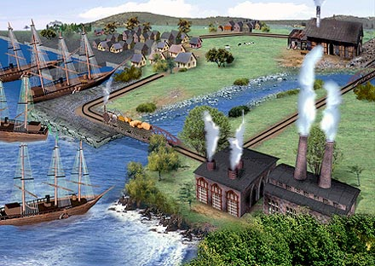
What changed after the Crusades?
Increased religious hatred
Christians vs. Muslims
Trade increased, economy grew
Cultural diffusion → Europeans learned a lot
Europe becomes stronger
Pope lost power & nobles gained power
This leads to nation-states & absolute monarchs
Feudalism ended & money system replaced it
Notes:
Most feudal lords were killed, so the ones who lived gained more power.

Slide 9
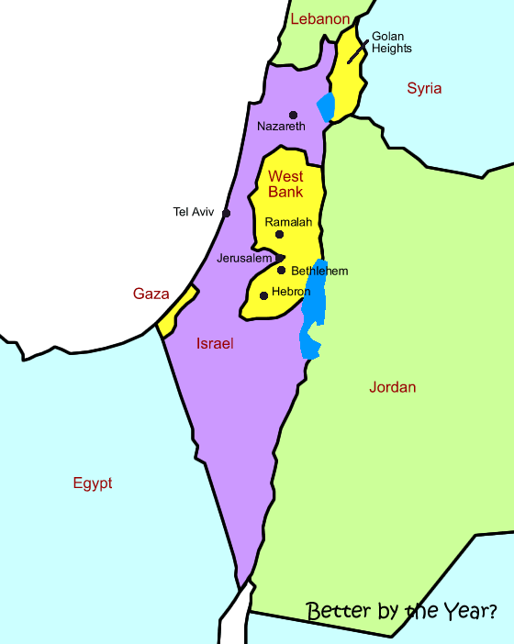
Who controls Jerusalem today?
Still an issue
Israel/Palestine
Judaism/Islam
Part of the Jewish state of Israel

