Slide 1
Vocab Week 1-3
Global 1
Ms. Lyons

Slide 2
Flip to the back page

Slide 3
PREFIX: Before
Ex- “out”
Exhale (breathe out)
YOUR PAPER
Ex-
out
exhale,

Slide 4
PREFIX: Before
Auto- “self”
Automobile (moves by itself)
YOUR PAPER
Auto-
self
automobile,

Slide 5
ROOT : word part from which other words grow
port “carry”
Portable (able to be carried)
YOUR PAPER
port
carry
portable,

Slide 6
SUFFIX: Added at the end of a word
-cracy “rule”
Democracy (people rule)
YOUR PAPER
democracy,
-cracy
rule

Slide 7
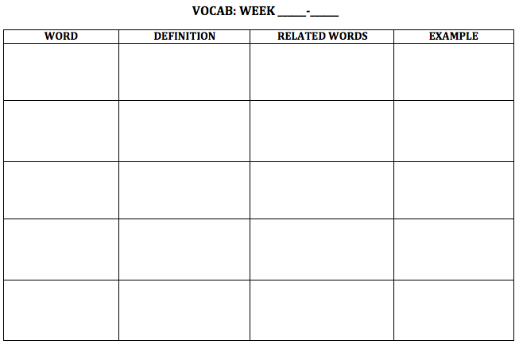
NEW WORDS!
Flip your paper over.
1
3

Slide 8
Mandate

Slide 9
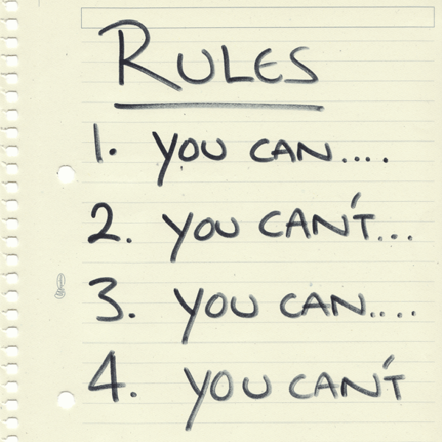
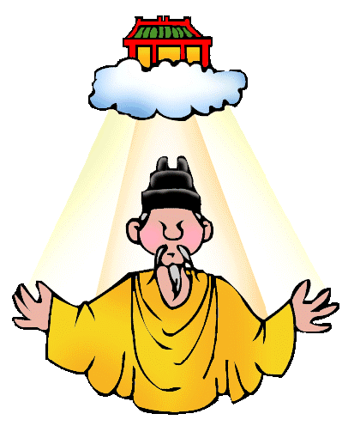
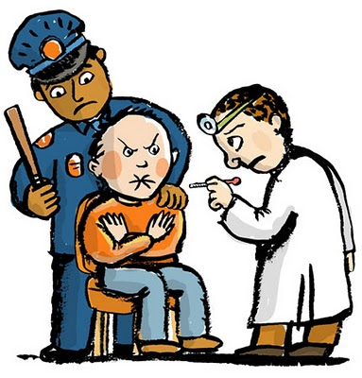
Mandate

Slide 10
Mandate
Definition: something you need to do
Related words: essential, mandatory, ruler
Example/Picture: write or draw your own

Slide 11
Autocracy

Slide 12
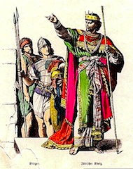
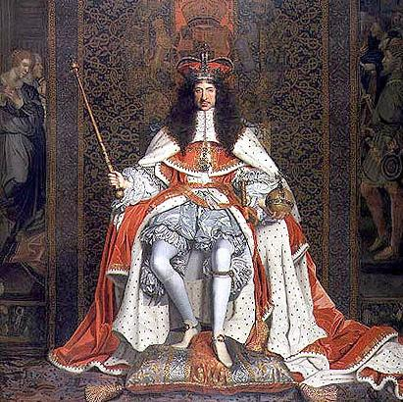
Autocracy

Slide 13
Autocracy
Definition: person who rules by his/herself (with total power)
Related words: monarchy, dictator, king
Example/Picture: write or draw your own

Slide 14
Patriarchal

Slide 15
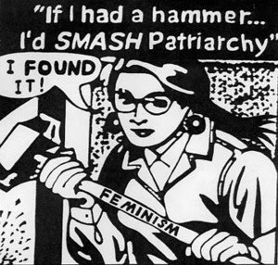
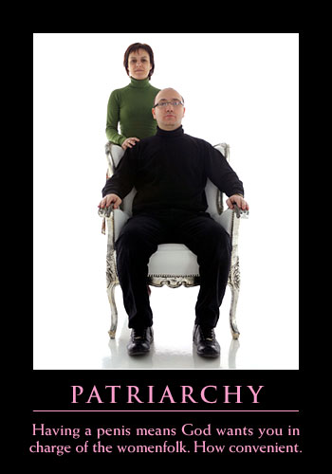
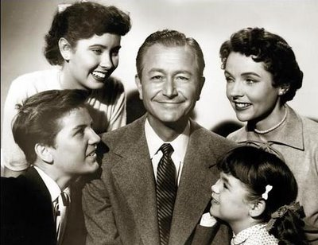
Patriarchal

Slide 16
Patriarchal
Definition: men rule
Related words: disrespect, unfair, fair
Example/Picture: write or draw your own

Slide 17
Export

Slide 18
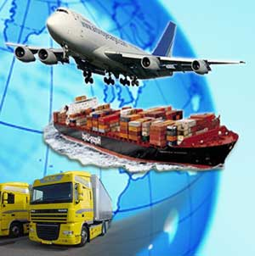
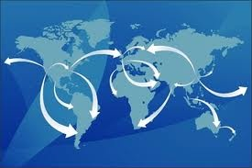
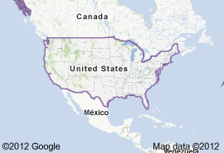
Export
EXPORTS (OUT)
IMPORTS (IN)

Slide 19
Export
Definition: carry out
Related words: trade, international, goods
Example/Picture: write or draw your own

Slide 20
Write 16 words.
-ist -logy -tion migr theo A- Arch Centr -ism -ize
Nomads Agriculture Migration Fertile Theology Ethnocentrism Monarchy Polytheism Peninsula centralize

