Slide 1
VOCAB Week 1-2
Global 1 Ms. Lyons

Slide 2
ROOT : word part from which other words grow
arch “ruler”
Anarchy, hierarchy
Patriarch (men are rulers)
YOUR PAPER
arch
ruler
Patriarch,

Slide 3
ROOT : word part from which other words grow
Centr “center”
Egocentric
Concentrate (center your attention on one thing)

Slide 4
SUFFIX: Added at the end of a word
-ism “belief”
Catholicism, racism
Polytheism (belief that gov’t should treat all people equally)
YOUR PAPER
Polytheism,
-ism
Belief

Slide 5
SUFFIX: Added at the end of a word
-ize “to cause/become”
Popularize, baptize
Colonize (to cause a country/area to become a colony of another country)

Slide 6
Ethnocentrism

Slide 7
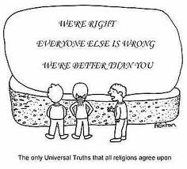
Ethnocentrism

Slide 8
Ethnocentrism
Definition: belief that their race/culture is central (best)
Related words: theo, polytheism, belief
Example/Picture: write or draw your own

Slide 9
Monarchy

Slide 10
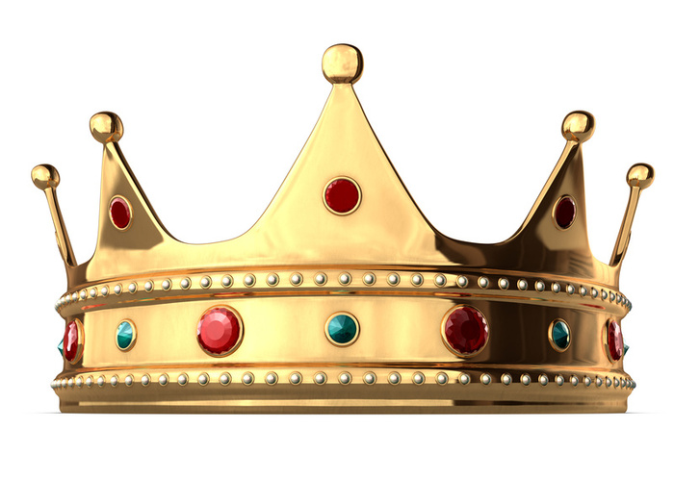
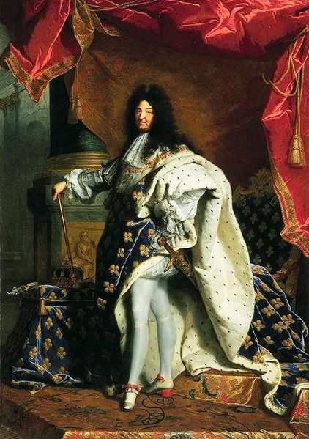
Monarchy

Slide 11
monarchy
Definition: government with one ruler
Related words: king, solo, crown
Example/Picture: write or draw your own

Slide 12
polytheism

Slide 13
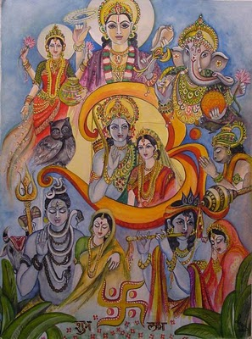
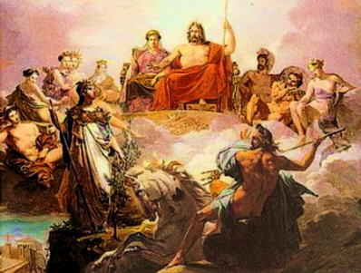
Polytheism

Slide 14
Polytheism
Definition: belief in many gods
Related words: monotheism, Greek, Christianity
Example/Picture: write or draw your own

Slide 15
Peninsula

Slide 16
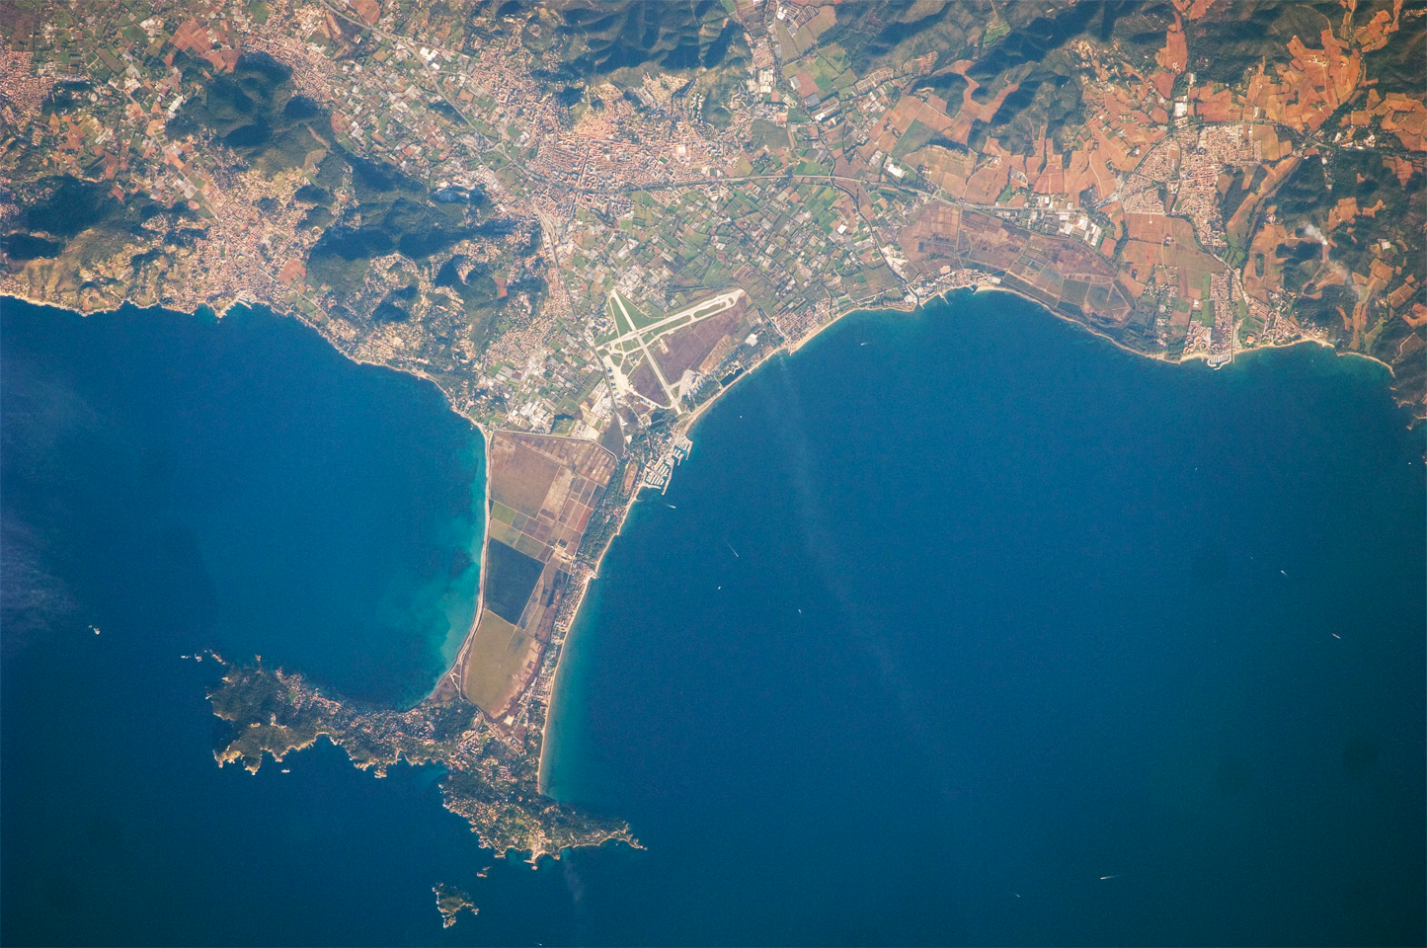
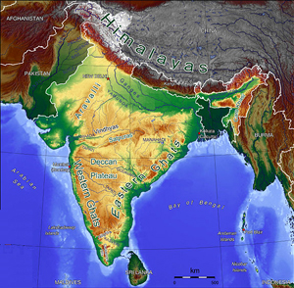
Peninsula

Slide 17
Peninsula
Definition: piece of land surrounded by water on 3 sides
Related words: Florida, island, Puerto Rico (island)
Example/Picture: write or draw your own

Slide 18
Centralize

Slide 19
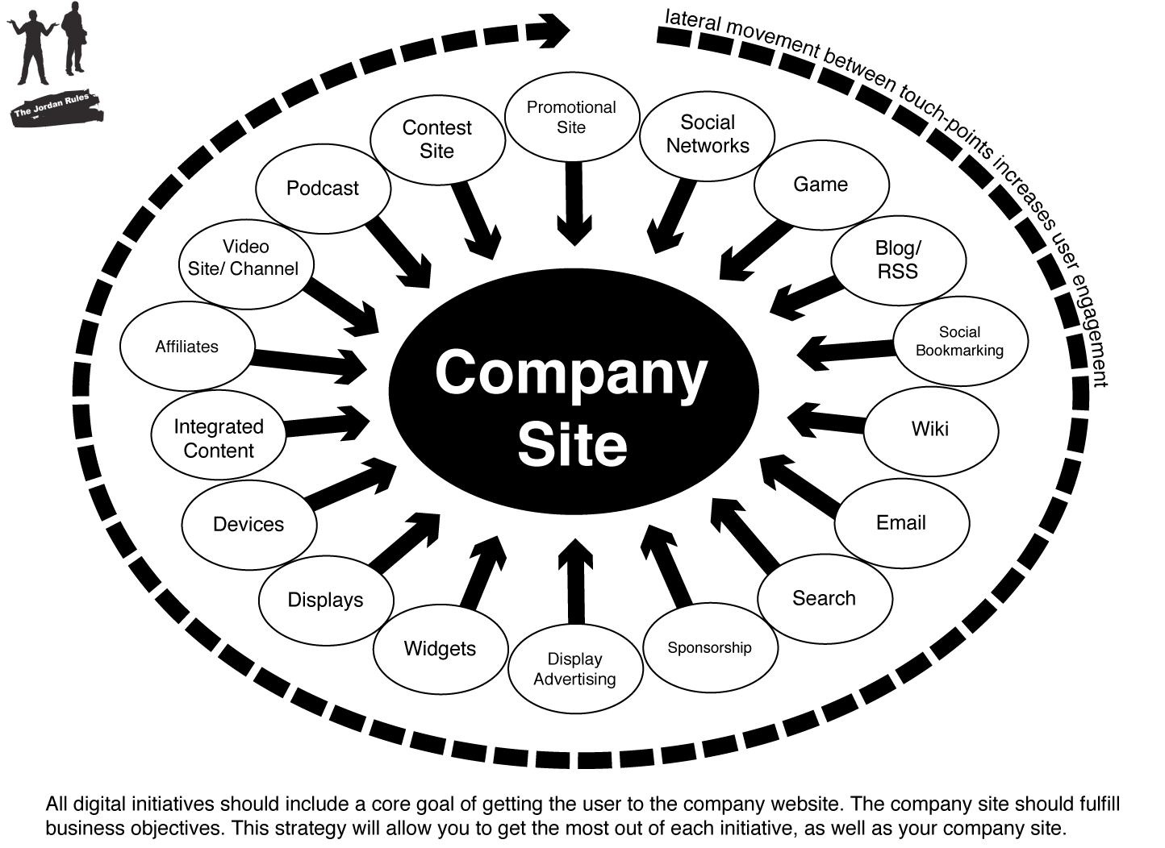
Centralize

Slide 20
Centralize
Definition: to put in all one central place
Related words: organize, gov’t, action
Example/Picture: write or draw your own

