Slide 1
VOCAB Week 1-1
Global 1
Ms. Lyons

Slide 2
UNFAIR
How many parts can I break this word into?
If we take out the first part, does the meaning change?

Slide 3
Example…
Don’t write this down.

Slide 4
SUFFIX
-ist “person who does something”
Scientist, florist, cartoonist
Economist (studies economy)
Sociologist (studies society)
Archaeologist (studies artifacts)
Political Scientist (studies politics)

Slide 5
Flip to the back page

Slide 6
SUFFIX: Added at the end of a word
2
-logy “study of”
Oceanology, biology
Ideology (studies ideas)
1
YOUR PAPER
3
Ideology,
-logy
Study of

Slide 7
SUFFIX
-tion “action”
Celebration, multiplication
Plantation (act of planting crops)

Slide 8
ROOT : word part from which other words grow
migr “moving to a new place”
Immigrant (person who moves into the country)
YOUR PAPER
migr
Moving to a new place
Immigrant,

Slide 9
ROOT
theo “God”
Atheist
YOUR PAPER
theo
God
Atheist,

Slide 10
PREFIX: Before
A- “not” or “without”
Anonymous, asexual
Amazon (without a breast)
Greek mythology: female warriors cut or burned off a breast to shoot a bow & arrow better
YOUR PAPER
A-
not or without
Amazon,

Slide 11
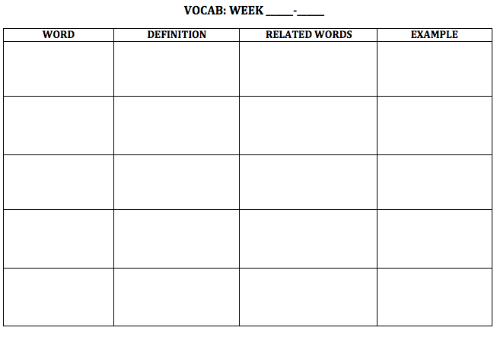
NEW WORDS!
Flip your paper over.
1
1

Slide 12
Nomads

Slide 13
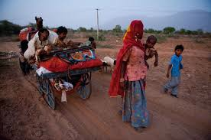
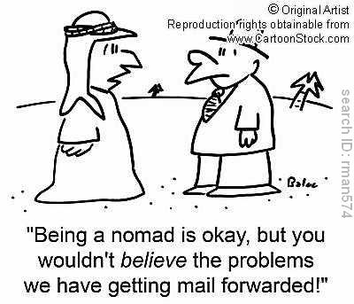
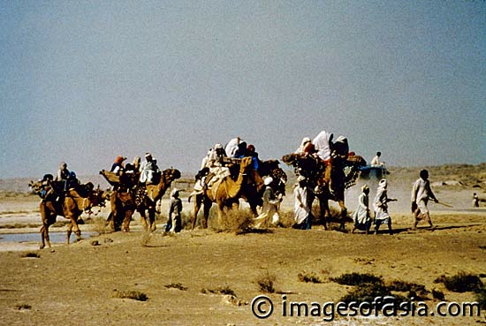
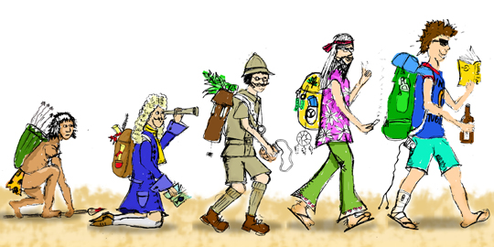
Nomads

Slide 14
Nomads
Definition:
Related words:
Example/Picture: write or draw your own

Slide 15
Migration

Slide 16
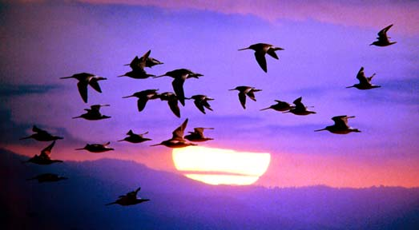
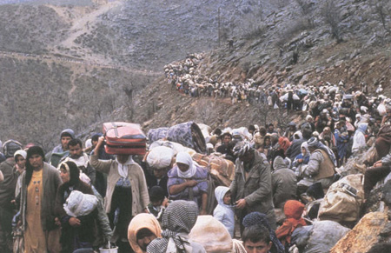
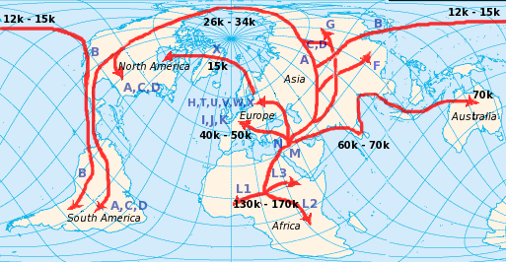
Migration

Slide 17
Migration
Definition:
Related words:
Example/Picture: write or draw your own

Slide 18
Agriculture

Slide 19
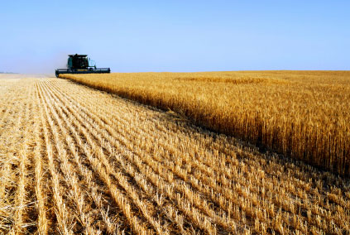
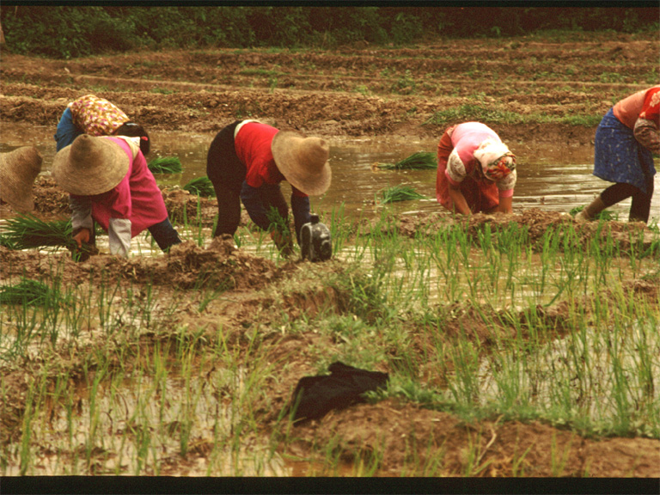
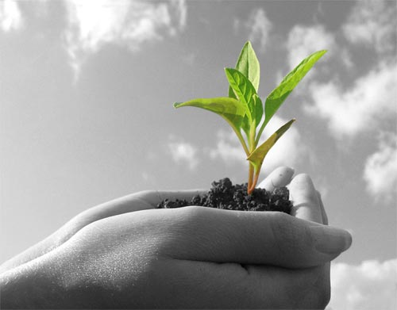
Agriculture

Slide 20
Agriculture
Definition:
Related words:
Example/Picture: write or draw your own

Slide 21
Fertile

Slide 22
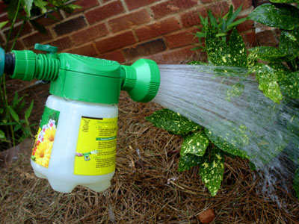
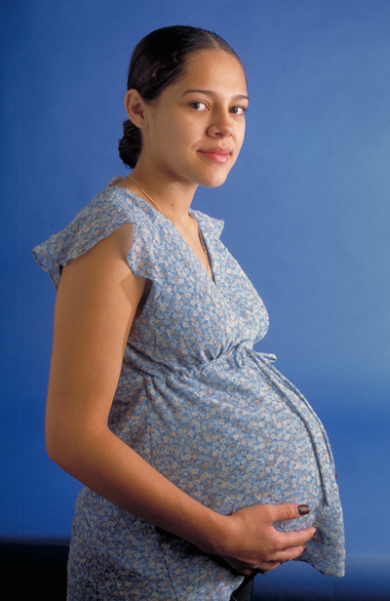
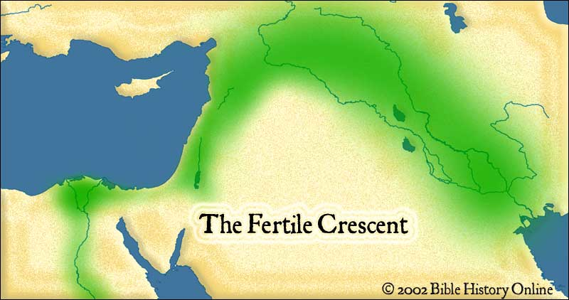
Fertile

Slide 23
Fertile
Definition:
Related words:
Example/Picture: write or draw your own

Slide 24
Theology

Slide 25
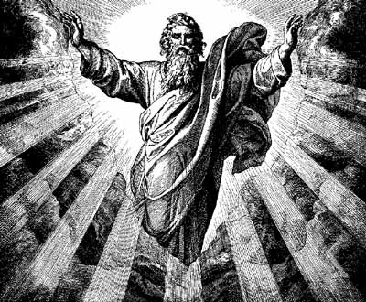
Theology

Slide 26
Theology
Definition:
Related words:
Example/Picture: write or draw your own

