Slide 1
Roman Empire
Global 1
Ms. Lyons

Slide 2
Geography
Peninsula
Mediterranean Sea
TRADE
Low mountains
UNITED
Fertile plains
AGRICULTURE

Slide 3
How was Rome Created?
Romulus & Remus
Twin princes
Raised by wolves
Took back throne & built big city
Fought over who to name the city after
Remus died & it was named Rome after Romulus

Slide 4
Roman Republic
Senate
Assembly
most power
Patricians
Rich, military & gov’t leaders
less power
Plebeians
Poor, working class

Slide 5
Twelve Tables
Set of laws
Posted for everyone to see
Examples:
All men are protected equally under the law
Have a right to face your accuser
Innocent until proven guilty
What other set of laws can you think of?

Slide 6
Rise of the Roman Empire
Rome gained control of all Italy & kept spreading
This led to civil wars!
Julius Caesar takes power in 48 BCE
Wins civil war
Becomes a dictator
Conquers more land with his military

Slide 7
Caesar is killed by the Senate
Senate losing power…not happy
Stab Caesar over 20 times
BUT they still don’t get power
Caesar’s grandnephew Augustus takes over
Names himself emperor

Slide 8
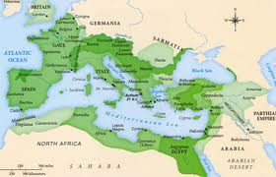
Pax Romana
Augustus in power leads to 200 years of peace & prosperity

Slide 9
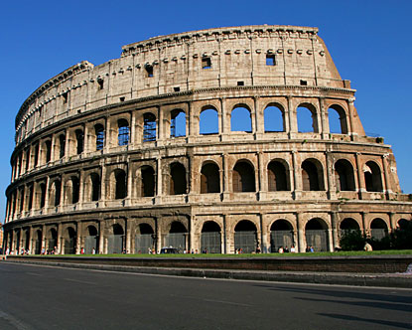
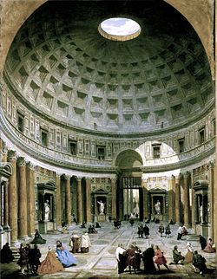
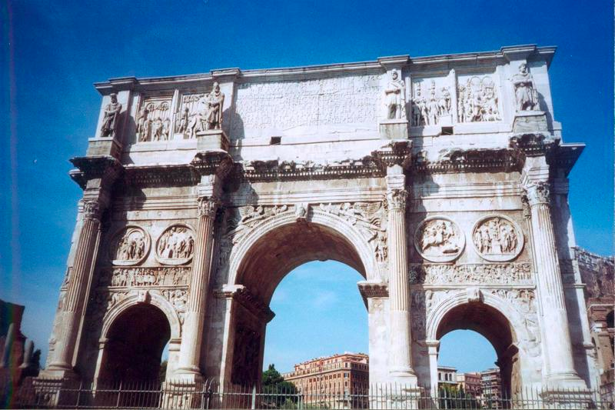
Roman Contributions
Art/Architecture: Copied Greeks (statues, columns)
Arch, dome
Pantheon
Language: Latin
Root of many languages
Spanish & English

Slide 10
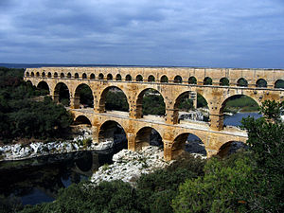
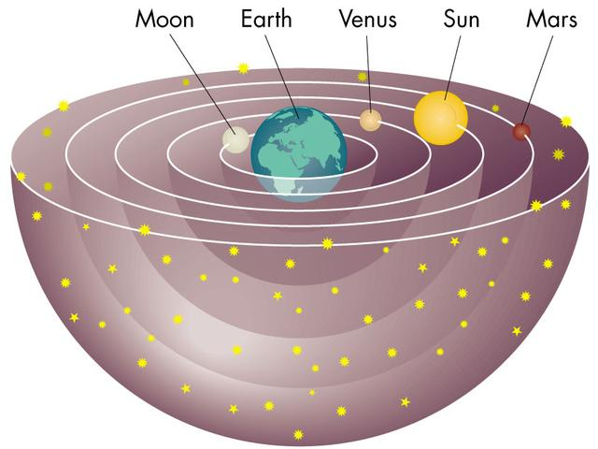
Roman Contributions
Public Works:
Roads, harbors, bridges
Aqueducts (move water into cities)
Irrigation: move water to crops
Science:
Ptolemy (Greek living under Roman rule)
Geocentric model of universe

Slide 11
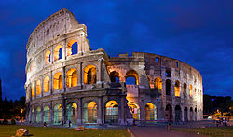
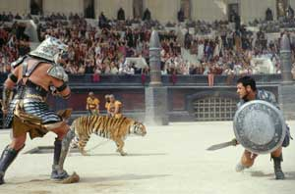
Roman Entertainment
Colosseum
Stadium where gladiators fought to the death

Slide 12
Gladiator
http://www.youtube.com/watch?v=FI1ylg4GKv8

Slide 13
THURSDAY: DBQ
1: SOURCE the document
Author, Setting, Audience, Purpose
2: Read & UNDERLINE
Words from the Question
Quiz words (vocab)
3: ANSWER the question
You can use words from the document!
4: OUTSIDE INFORMATION
You know something extra!
What details are missing?

Slide 14
FRIDAY: Thematic Essay Outline
Golden Age

