Slide 1
Belief Systems
Global 1
Ms. Lyons

Slide 2
Islam

Slide 3
Islam
How It Began:
Founder: Muhammed
Point of Origin: Mecca (Saudi Arabia)
622 C.E.
A Muslim must make a pilgrimage to Mecca once in their life.

Slide 4
Islam [cont.]
How it Spread:
Trade
Where Most Influential Today:
Middle East & North Africa
Followers, worldwide:
1.4 billion
Prayer 5 times a day is part of the Five Pillars. When praying it is important to face the direction of Mecca, thus, everyone in the above picture is facing the same direction.

Slide 5
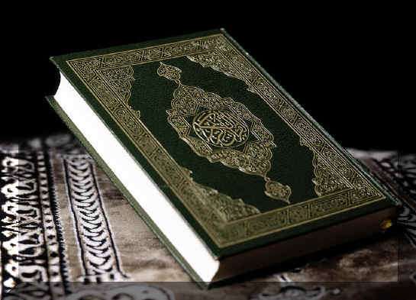
Islam [cont.]
Holy Book:
The Qur'an (or Koran)
Main God/gods/deities:
Allah
Basic Beliefs:
Strictly monotheistic
Muslims must practice 5 Pillars of Islam
Only believe in Allah
Fasting during Ramadan
Prayer 5 times a day
Pilgrimage to Mecca
Give money to the poor
The sacred text of Islam is the Qur’an, which is shown
in the above picture.

Slide 6
Islam [cont.]
Religious Leader Organization:
Caliph is Islamic leader.
Sects Evolved Overtime:
Shiites
Sunnis
The Holy Mosque (Masjid Al-Haram) in Mecca is the most famous Mosque in the world.

Slide 7
Buddhism

Slide 8
Buddhism
How It Began:
Founder: Siddhartha Gautama (The Buddha)
Point of Origin:
India
c. 525 B.C.E.
The Life of a Buddhist Monk is meant to be simplistic. Thus, the shave their heads and wear robes in order to rid themselves of vanity.

Slide 9
Buddhism [cont.]
How it Spread: Trade
Where Most Influential: Asia
Followers, worldwide: 400 million
Holy Book: Tripitaka (The 3 Baskets of Wisdom)
The Dharmashakra represents the Eightfold Path.

Slide 10
Buddhism [cont.]
Main God/gods/deities:
no divine being
Basic Beliefs:
Karma
Reincarnation
Four Noble Truths

Slide 11
Four Noble truths
Life = suffering
Origin of suffering is desire.
Suffering can stop.
By following the correct path, one can achieve Nirvana (the state of no suffering).
The Eightfold Path will stop the suffering

Slide 12
Christianity

Slide 13
Christianity
How It Began:
Founder: Jesus Founded: c. 33 C.E.
Point of Origin:
Palestine
A painting of Jesus Christ.

Slide 14
Christianity [cont.]
How It Spread:
Constantine made it the official religion of the Roman Empire.
Where Most Influential Today:
Europe, North America, and South America
Followers, worldwide:
2 billion
Jesus Christ died on the Cross in order to forgive everyone’s sins, thus, the cross is a symbol to represent Christianity.

Slide 15
Christianity [cont.]
Holy Book:
The Bible
Main God/gods/deities:
God
Basic Beliefs:
Monotheistic
Jesus was the son of God
Heaven and Hell

Slide 16
Christianity [cont.]
Religious Leader Organization:
The Pope is head of the church.
Sects Evolved Overtime:
Main sects include
Roman Catholic
Eastern Orthodox
Protestant
A church of Eastern Orthodox, one sect of Christianity.

Slide 17
Hinduism

Slide 18
Hinduism
How It Began:
Founder: Unknown
Point of Origin:
India
c. 1500 B.C.E.
Symbol for Hinduism.

Slide 19
Hinduism [cont.]
How It Spread:
Trade
Where Most Influential Today:
India and Nepal
Followers, worldwide:
900 million
A statue of Shiva, a Hindu trinity God.

Slide 20
Hinduism [cont.]
Holy Book:
Vedas, Upanishads, Bhagavad Gita
Main God/gods/deities:
Brahman, Shiva, Vishnu
Basic Beliefs:
Karma
Reincarnation
Caste system

Slide 21
Judaism

Slide 22
Judaism
How It Began:
Founder: Abraham
Point of Origin:
Israel
c. 2000 B.C.E.
For each night of Hanukah, a Jewish holiday,
one candle is lit on the menorah.

Slide 23
Judaism [cont.]
How It Spread:
Started by passing down through families.
Where Most Influential Today:
Israel
Followers, worldwide:
15 million

Slide 24
Judaism [cont.]
Holy Book:
The Torah
Main God/gods/deities:
God
Basic Beliefs:
Stresses ethical behavior (10 commandments)
Jesus was a prophet, not the son of God
The Holy Book of Judaism, the Torah.

Slide 25
Confucianism

Slide 26
Confucianism
How It Began:
Founder: Confucius
Point of Origin:
China
500 B.C.E.
The Chinese symbol for Confucianism.

Slide 27
Confucianism [cont.]
How It Spread:
Chinese tradition; Became state doctrine for the Han Dynasty
Where Most Influential Today:
China
Followers, worldwide:
6 million
An analect of Confucianism.

Slide 28
Confucianism [cont.]
Holy Book:
The Confucian Analects, The Book of Filial Piety
Main God/gods/deities:
None
Basic Beliefs:
5 relationships
Filial piety (respect your parents)

