Slide 1
Mesoamerica
GLOBAL 1
MS. LYONS

Slide 2
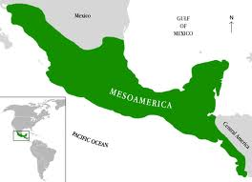
Geography
Southern Mexico & Central America
Mountains
Plains
Gulf of Mexico & Pacific Ocean
Rain forests
Slash & burn agriculture

Slide 3
3 MAJOR Cultures
Maya
Aztec
Inca

Slide 4
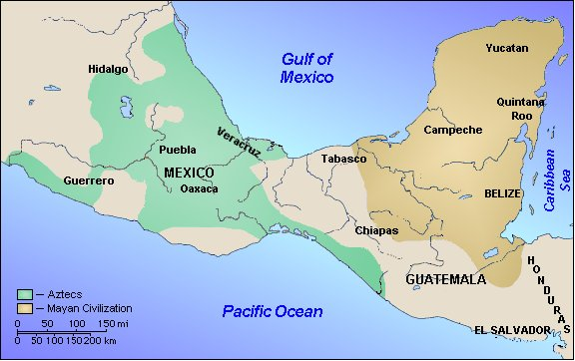
Maya
300 CE – 900 CE
City-states
Yucatan Peninsula (Mexico & Central America)

Slide 5
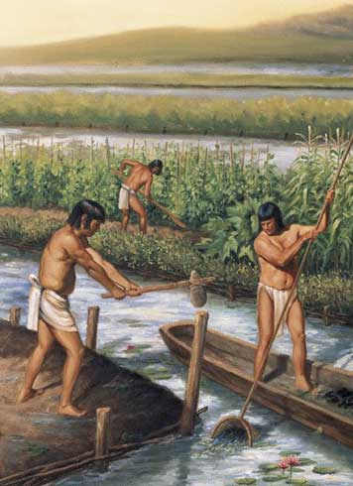
How did geography affect life in Maya?
Plains = Agriculture
Irrigation systems
Grew: corn, beans, squash
Peninsula = Trade

Slide 6
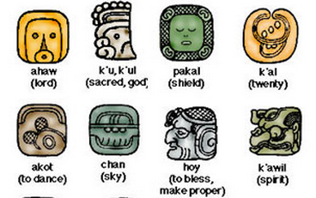
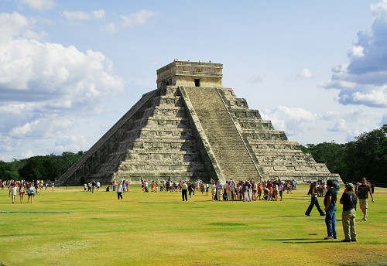
Mayan Contributions
Writing system – pictograms
365-day calendar
Numbering system including zero
Pyramid-shaped temples with steps
Tallest buildings in America until 1903

Slide 7
Aztec
1200’s CE – 1521 CE
Southern Mexico
Capital – Tenochtitlan

Slide 8
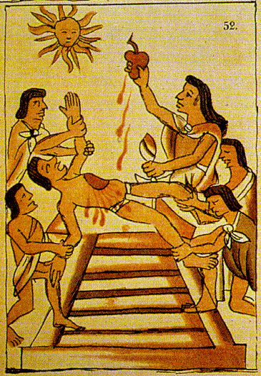
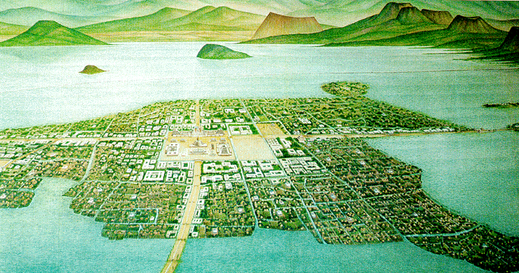
Aztec Contributions
Strong, central government
Aqueducts, causeways (road over water)
Large temples, human sacrifice
Large stone carvings, colorful paintings

Slide 9
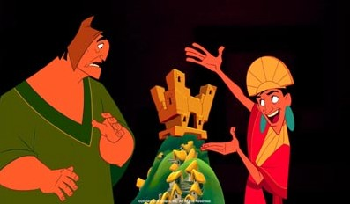
Inca
1400’s CE
Pacific Coast of South America
Capital – Cuzco

Slide 10
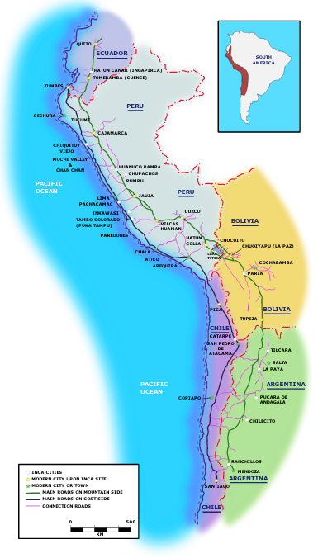
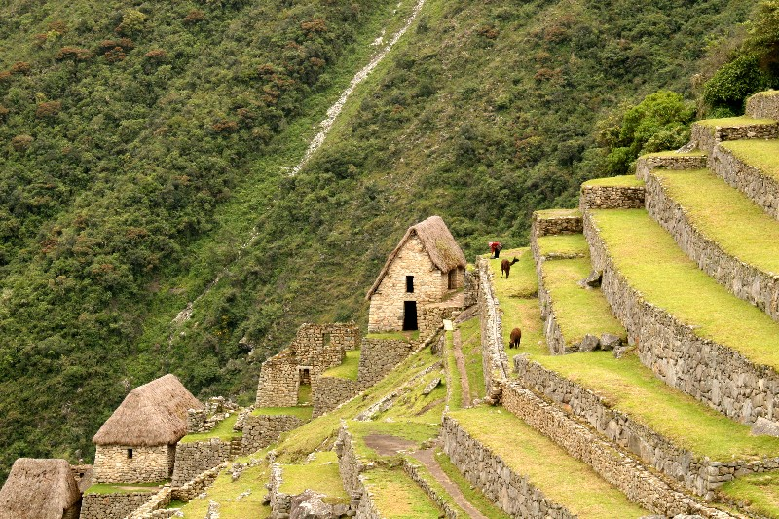
How did geography affect life in Inca?
BIG empire
12,000+ miles of ROADS!
Linked the empire, used relay runners
Mountains
Terrace farming

Slide 11
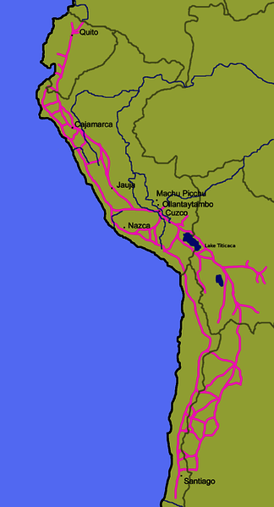
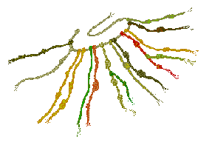
Incan Contributions
Wealthy & stable culture
ROADS!
Science
Surgery
Kept records using quipas
Knotted string

