Slide 1
Mongol empire
GLOBAL 1
MS. LYONS

Slide 2
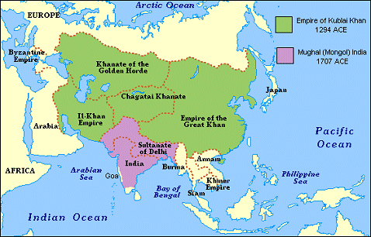
Geography
1200 CE
Central Asia
Russia, Eastern Europe, China, India, Middle East
Biggest empire ever
not counting the British during imperialism

Slide 3
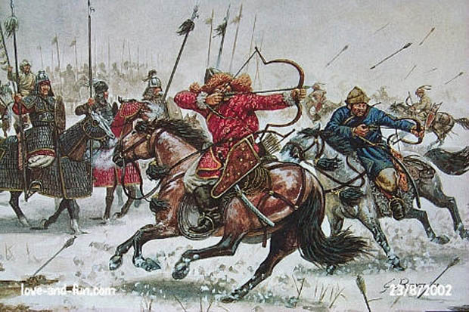
How did they build their empire?
Nomadic tribe
Warriors – shot arrows from horseback
Technology (cannons from China)
Tolerant rulers

Slide 4
1. Genghis Khan
1162-1227
Born with blood clot in his fist
a sign he would be a great leader
Re-named himself: “Universal Ruler”
Killed most people he conquered
Mongols couldn’t read/write
Mongols had no strong government
Notes:
Stabilized Silk Road
Raped the women
16 million descendants living today

Slide 5
2. Kublai Khan
1215-1294
Son of Genghis Khan
Called: Wise Khan
Kind to people conquered
Took over China during the Song Dynasty
Learned about government from Confucian scholars
United China
Called his rule “Yuan Dynasty”

Slide 6
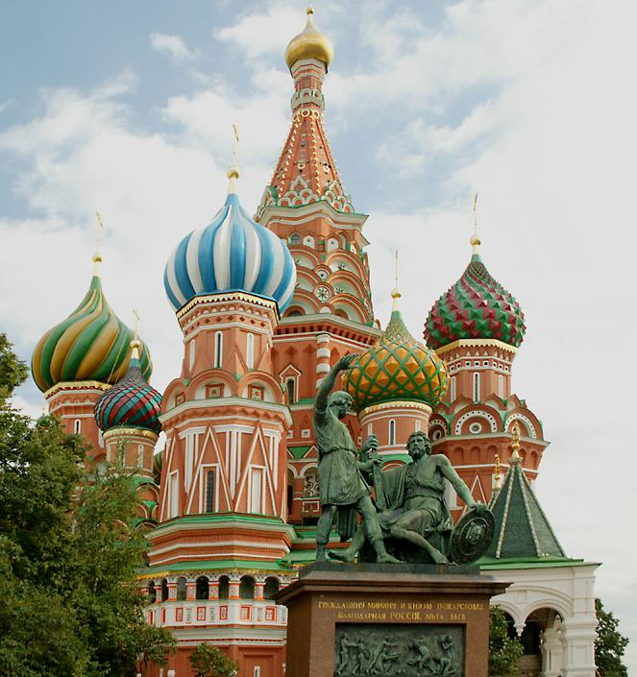
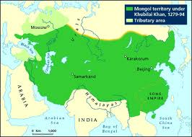
Mongols influence Russia
Showed them absolute government
100% control
Isolated Russia from Western Europe
Cut off from lots of arts & science

Slide 7
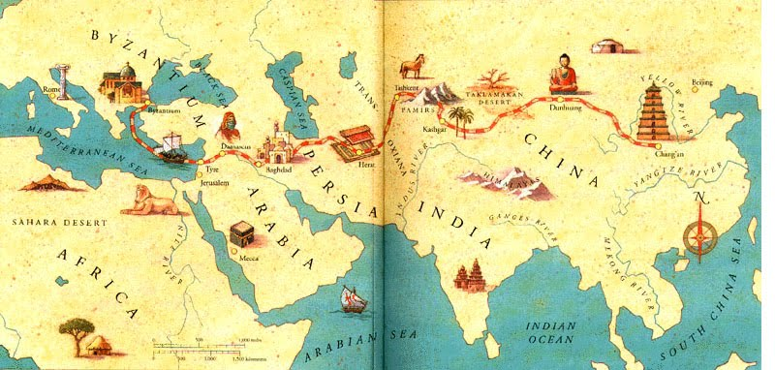
Pax Mongolia
Stable, connected East & West: good for trade
Silk Road exchanged:
Gunpowder
Porcelain
Papermaking technology
Cultural diffusion!
Explorers came to Mongol courts!
Marco Polo (Italy)
Ibn Battuta (Morocco)
Notes:
"a maiden bearing a nugget of gold on her head could wander safely throughout the realm.”

Slide 8
Fall of the Mongol Empire
Too much land to control
Weak government
Strong leaders died
China & other countries wanted independence
Rebelled against their Mongol rulers

Slide 9
ISLAMIC EMPIRE
GLOBAL 1
MS. LYONS

Slide 10
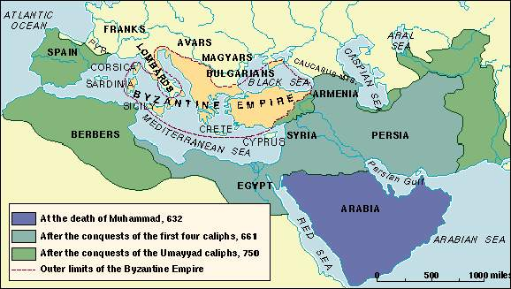
Geography
700’S-800’S C.E.
Started in Saudi Arabia
Spread to 3 continents
Mediterranean & Arabian Seas

Slide 11
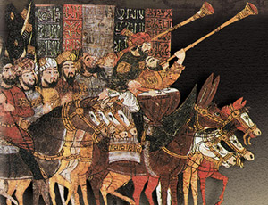
How did the Islamic Empire get so big?
Strong armies
Horses & camels
Common language
Arabic
Treated conquered people fairly
Didn’t rebel, stayed united

Slide 12
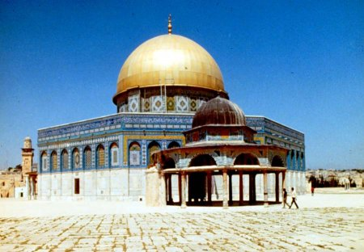
Cultural Diffusion
Blended Arab, Persian, Egyptian, European cultures
Borrowed domes & arches from Byzantine Empire
TRADING increases cultural diffusion!

Slide 13
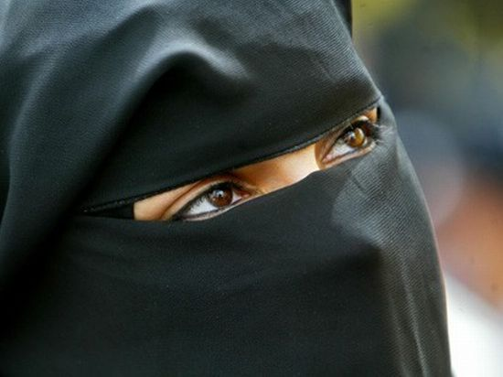
Religion
Islam
Sharia law
Based on the Qur’an
EXAMPLES OF LAWS:
A Muslim will be forgiven for murder of a non-Muslim.
Death by stoning for adultery or prostitution
Chop off hand for stealing
NOTE: veiling women is not from the Qur’an – it came from the Byzantines & Persians.

Slide 14
Women in Islam
Improved the status of women at the time
Muhammad's 1st wife was his boss & she proposed to him
Islam made it illegal to bury alive unwanted female babies
Encouraged females to get an education
Gave women the right to own and inherit property
http://www.voanews.com/content/new-documentary-shows-how-islam-empowers-women/1555927.html
Notes:
http://www.pbs.org/muhammad/video/quicktime/56k/ma_women16x9.mov

Slide 15
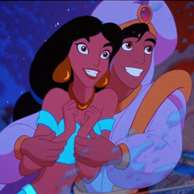
Literature
The Thousand and One Nights
Includes Aladdin and His Magic Lamp

Slide 16
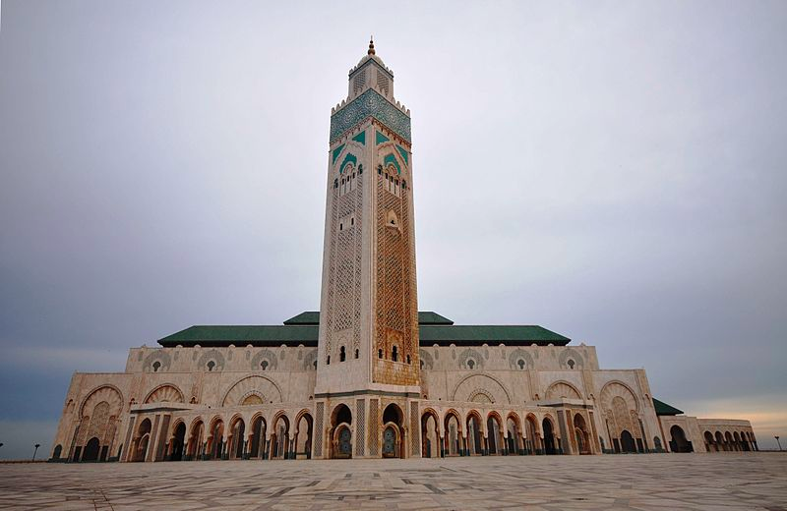
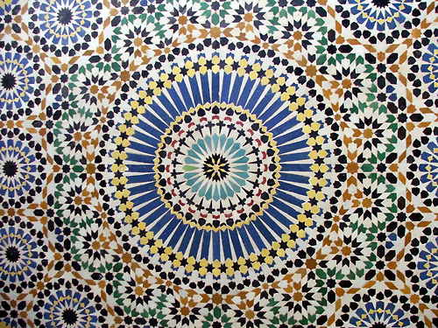
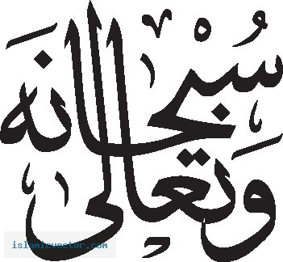
Art
Calligraphy
Geometric art

Slide 17
Math
Created algebra

Slide 18
Science
Medical encyclopedias
Calculated circumference of the Earth
First Emergency Rooms
First to put sugar in medicine so people will take it

