Slide 1
New Game Plan
Global 1
Ms. Lyons / Mr. Chacko

Slide 2
GLOBAL 1 1/2/13 AIM: What will the classroom behavior & curriculum look like for the rest of the year? DO NOW: Create a New Year’s Resolution for Global Class. *How will you keep yourself on track to complete this goal?

Slide 3
Grading System
Character & Classwork …………30%
Homework …………………………10%
Current Events ……..…………….10%
Quizzes ……………………………..10%
Projects…………………………..…15%
Tests…………………………………25%
Notes:
Entire school uses

Slide 4
Learning Journal Points
Total points earned / total possible points
THIS IS 30% of your grade
Character & classwork

Slide 5
Current Grades
29% 19% 0% 62% 23% 98% 15% 0% 38% 83% 61% 42% 25% 46% 67% 75% 58% 37% 14% 17% 85% 59% 0% 77% 38% 64% 40% 14% 37% 14% 18% 92% 14% 20%
Notes:
8 passing

Slide 6
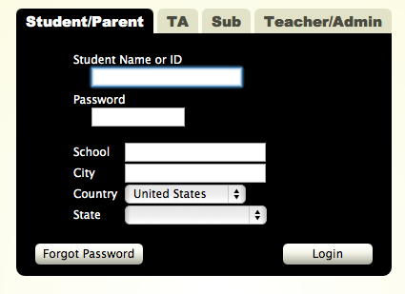
www.jupitergrades.com

Slide 7
www.socialstudieswithmslyons.weebly.com

Slide 8
What’s on the site?

Slide 10
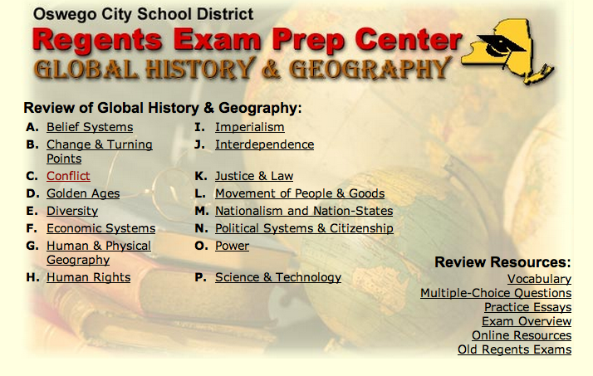
www.regentsprep.org

Slide 11
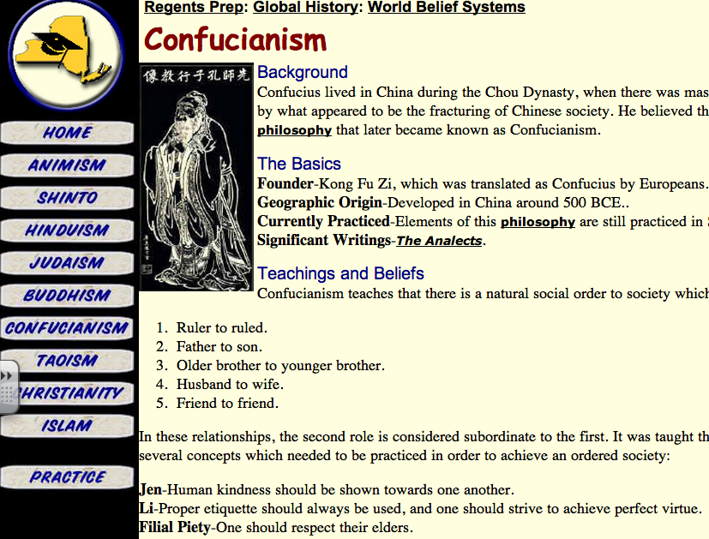

Slide 12
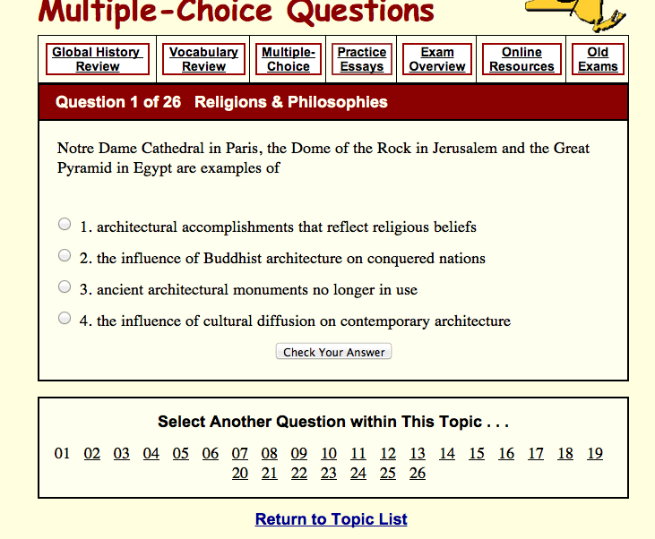

Slide 13
www.nysedregents.org

Slide 14
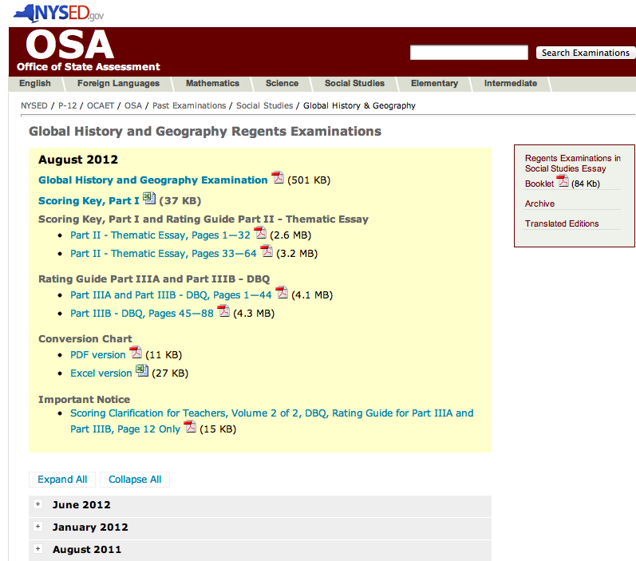

Slide 15
My e-mail address
LLyons3@schools.nyc.gov

Slide 16
Classroom Rules
RESPECT OTHERS
Don’t give up

Slide 17
Class Roles
3 min warning (check classwork, answer Aim)

Slide 18
4 Corners
10 statements
Choose one corner & stand there.
STRONGLY AGREE
AGREE
DISAGREE
STRONGLY DISAGREE

Slide 19
Statement 1
School should be mandatory.

Slide 20
Statement 2
I enjoy learning new things.

Slide 21
Statement 3
I am smart.

Slide 22
Statement 4
I want to go to college.

Slide 23
Statement 5
I feel school is a safe place.

Slide 24
Statement 6
I learn best when I feel safe.

Slide 25
Statement 7
I have people in my life that encourage me to do well in school.

Slide 26
Statement 8
I learn best by seeing (pictures, movies, charts).

Slide 27
Statement 9
I learn best when I can move around.

Slide 28
Statement 10
I learn best by talking and discussing the subject.

Slide 29
Curriculum
Stuff we will learn this year

Slide 30
What we need to learn this year…
Style of Regents Exam
Topics for Fall
Topics for Spring
Skills (CCLS)

Slide 31
Take 5 minutes to create a poster in your group
REGENTS
3 sections
Types of multiple-choice questions
TOPICS FOR FALL & SPRING
MOST important topics
SKILLS
MOST important
Activity ideas to practice this skill?

Slide 32
Homework
Find a current events article. Print it or cut it out.
www.CNN.com
www.time.com
The New York Times

