Slide 1
Review for Final Exam
Global 1
Ms. Lyons & Mr. Chacko

Slide 2
Vocabulary
Break down the word
Prefixes
  Mono- (one) …
  Demo- (people) …
Roots
  Arch (rule) …
  Cracy (rule) …
Suffixes
  -ism (belief) …

Slide 3
Try it…
Monotheism
  ONE / GOD / BELIEF
Monarchy
  ONE / RULE
Democracy
  PEOPLE / RULE
Ethnocentrism
  RACE / CENTER / BELIEF

Slide 4
VOCABULARY
Fertile – able to grow
Agriculture – farming
Irrigation – bringing water to crops
Geography - study of the physical earth & human impact
Subsistence – just enough to survive
Surplus – extra
Civic – citizen’s duty to keep things civilized
Philosopher – thinker (lover of wisdom)

Slide 5
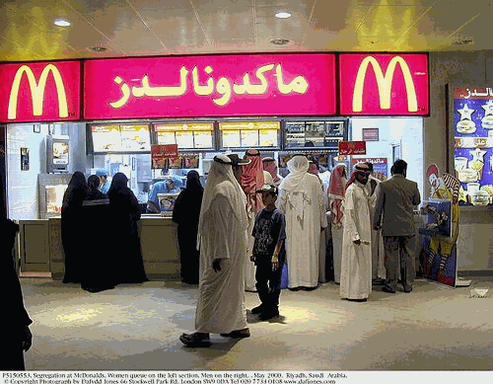
Cultural Diffusion
Spread of culture
  Ideas, goods, traditions…
How did it happen?
  Trade
  War

Slide 6
Scientists
SUFFIX: “-ist”
  Person who does something
Archaeologist
  Studies artifacts
Economist
  Studies the exchange of goods & services

Slide 7
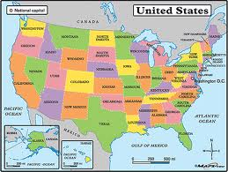
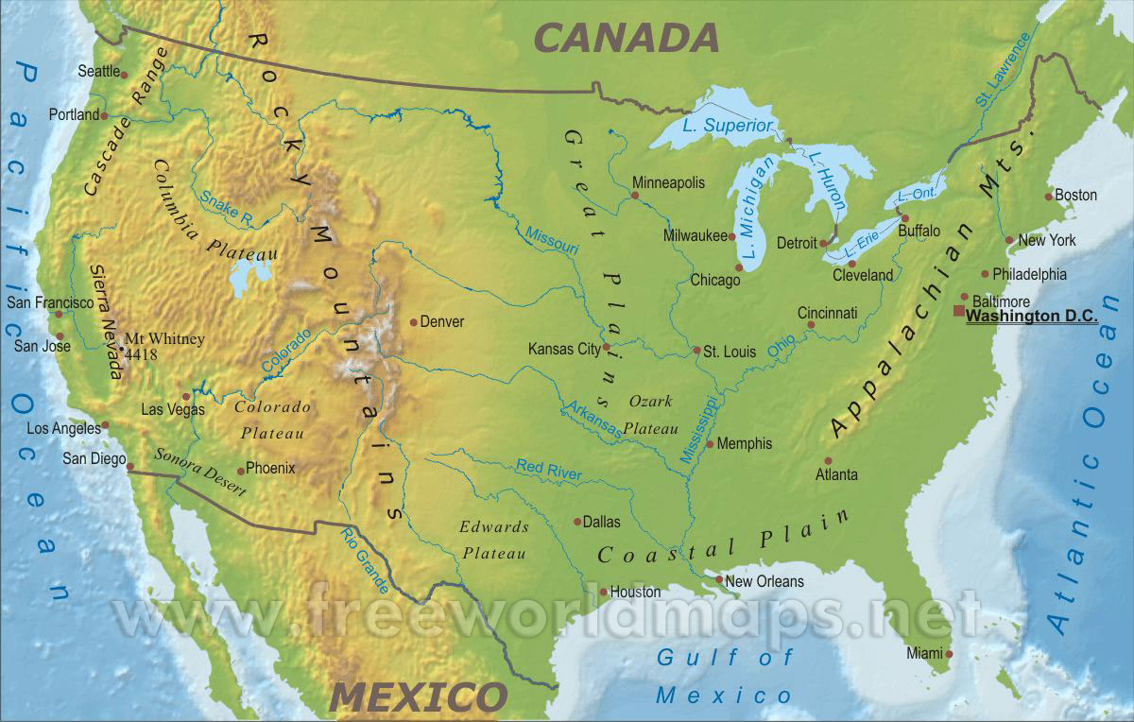
Types of maps
Political
  Shows borders of cities, states, countries (MAN-MADE STUFF)
Topographic
  Shows elevation & land types (NATURE-MADE STUFF)

Slide 8
Neolithic Revolution
BEFORE
AFTER
Nomads
Hunters & gatherers
Permanent settlements
  Houses
Grew food!
  Domesticated animals
Notes:
Social Classes
Technology
Plows, wheel, metal weapons, calendars

Slide 9
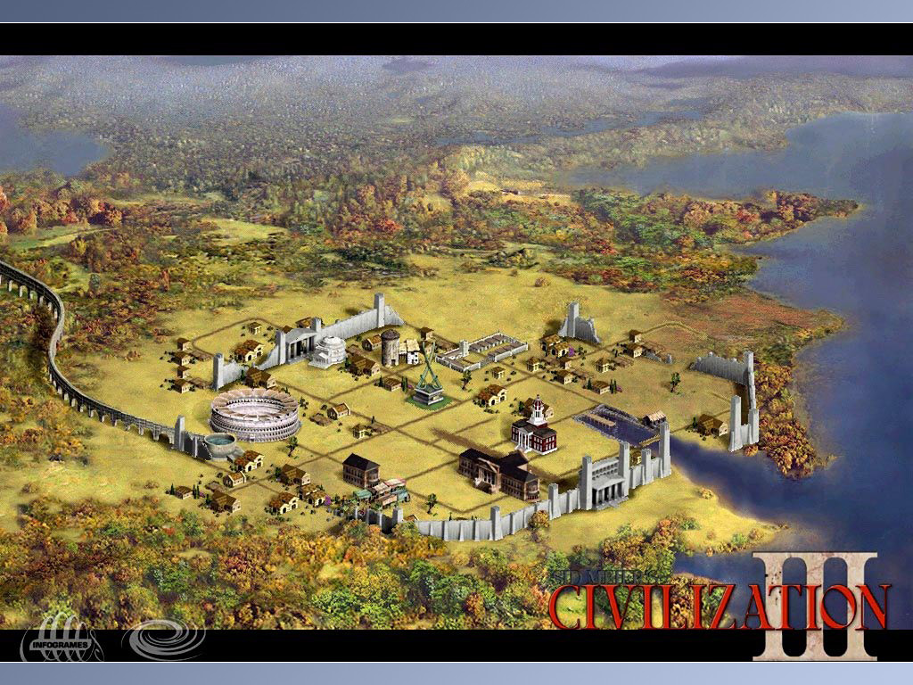
Parts of civilization
G eography
G overnment
R eligion
E conomics
A rt/Architecture
S cience/Technology
E ducation
S ocial Structure

Slide 10
Geography
GEOGRAPHIC FEATURE | CIVILIZATION | EFFECT
Rivers | Mesopotamia, Egypt, Indus, China | Travel, trade, irrigation (water for crops)
Mountains | Greece, China | ISOLATES, divides (city-states)
Peninsula | India, Greece, Italy (Rome) | Water → travel & TRADE!
Monsoons | India | Floods, waters crops
Isolated | China | Ethnocentrism, protection, NO trade

Slide 11
RIVER VALLEY CIVILIZATIONS
CIVILIZATION | RIVER(S) | GEOGRAPHY | GOV’T | SYSTEM OF WRITING | RELI- GION
Mesopotamia (Sumer, Babylon) | Tigris, Euphrates | Flat plains, no barriers | Hammurabi’s Code | Cuneiform | Poly
Egypt | Nile | Desert, mountains, & ocean borders | Pharaohs (50% king, 50% god) | Hieroglyphics | Poly
Indus River Valley | Indus | Peninsula | Urban planning (grid) | Pictograms (still can’t read them!) | Poly
China | Huang He (Yellow) | Mountains, deserts, ocean *MOST ISOLATED | Dynasties (royal families) | Pictograms | Poly

Slide 12
Comparing River Valley Civilizations
SAME
DIFFERENT
Fertile soil (rivers)
Writing systems
Monarchs
Polytheistic
Geography (borders)
Hieroglyphics, cuneiform, pictograms
God-like/regular people

Slide 13
Government
TYPE OF GOV’T | DEFINITION | CIVILIZATION
Democracy | People rule | Greece
Republic | People vote for representatives | Rome
Totalitarian

Slide 14
LAWS
SET OF LAWS | CIVILIZATION | MAIN IDEAS
Hammurabi’s Code | Babylon (Mesopotamia) | 1st posted laws, HARSH! “eye for an eye”
12 Tables | Rome | “Innocent until proven guilty”
Legalism | China (Qin dynasty) | HARSH! Confucianism Shi Huangdi

Slide 15
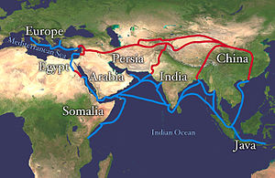
TRADE!
Water – good for travel & trade
TRADING → CULTURAL DIFFUSION!
Trade Routes:
  Silk Road

Slide 16
China: Tang/song
Religion
  Confucianism
Golden Age
Inventions!
  Civil service exam
  Calligraphy
  Gun powder
  Block printing

Slide 17
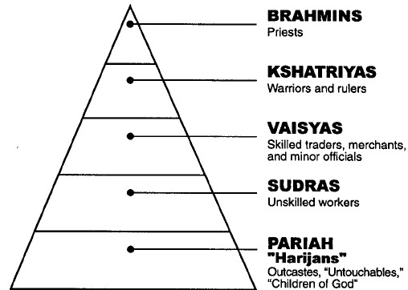
India: gupta
Golden Age
  Peace, wealth, inventions
Inventions
  Concept of “zero”
  Decimal system
Hinduism
  Caste system

Slide 18
Ancient greece
Geography – peninsula, mountains
Government – city-states, competed in Olympics
Religion – polytheistic
Economics – TRADE! (close to water)
Art/Architecture – columns
Science/Technology – Geocentrism (Earth = center of world)
Education – philosophers (Socrates, Plato, Aristotle)
Social Structure – #1 = free men, #2 = women, #3 = slaves

Slide 19
Powerful City-States
ATHENS
SPARTA
Spoke Greek
Direct democracy
  All men have a vote
“Book” smarts
  philosophers
Women
  not seen outside the home
Spoke Greek
Monarchy
  king
Warriors
  Like the movie 300
Women
  more free than in Athens

Slide 20
Athens v. Sparta Videos
http://www.youtube.com/watch?NR=1&feature=endscreen&v=gI6sARmxEuc
  300: “What is Your Profession?”
http://www.youtube.com/watch?v=uLyW5UYPYYs
  Wife Swap: Athens & Sparta

Slide 21
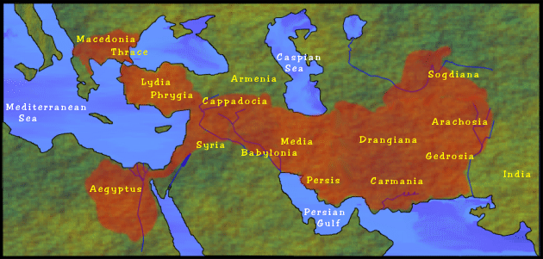
Alexander the great
Conquered a LOT of land
Cultural diffusion → Hellenistic Culture

Slide 22
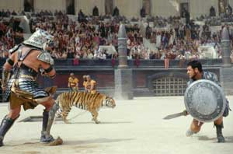
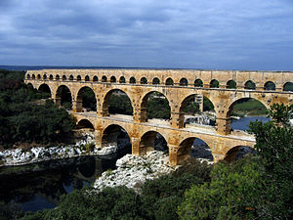
Rome
R’s
  Republic
  12 Tables
  Roads
Geography
  Peninsula (trade), fertile plains (agriculture)
Leaders
  Julius Casear
  Augustus (Pax Romana) – Roman peace for 200 years!
Religion
  Polytheistic
Contributions
  Aqueducts (move water to cities)
  Arch, dome
  Colosseum

Slide 23
Religions
RELIGION | FOUNDER | ORIGIN | HOLY TEXT | GOD(S) | BASIC BELIEFS
JUDAISM | Abraham | Israel 2000 BCE | Torah | God Monotheistic | 10 Command-ments Jesus was a prophet
CHRISTIANITY | Jesus | Jerusalem ? 33 CE | Bible | God Monotheistic | Jesus was the son of God
ISLAM | Muhammad | Mecca (Saudi Arabia) 622 CE | Qur’an | Allah Monotheistic | 5 Pillars

Slide 24
Religions …
RELIGION | FOUNDER | ORIGIN | HOLY TEXT | GOD(S) | BASIC BELIEFS
HINDUISM | Unknown | India, 1500 BCE | Vedas, Upanishads | Shiva, Vishnu… Poly | Karma Reincarnation Caste system
BUDDHISM | Siddhartha Gautama (Buddha) | India, 525 BCE | Tripitaka (3 Baskets of Wisdom) | None | Karma Reincarnation 4 Noble Truths
CONFUCIAN-ISM | Confucius | China, 500 BCE | Analects | None | 5 relationships, Filial piety (respect your parents)

Slide 25
Religions …
RELIGION | FOUNDER | ORIGIN | HOLY TEXT | GOD(S) | BASIC BELIEFS
TAOISM |  | China |  | None | Balance, yin-yang
ANIMISM |  | Africa |  | None | All things in nature have a spirit
SHINTO |  | Japan |  | None | Worship nature

Slide 26
DBQ: analyze a document
1: SOURCE the document
  Who, Where, When, Primary/Secondary Source?
2: Read & UNDERLINE
  Words from the question
  Vocabulary words
3: OUTSIDE INFORMATION
  You know something extra!
  What details are missing?
4: ANSWER the question
  You can use words from the document!

