Slide 1
Cultures & Neolithic Revolution
Global 1
Ms. Lyons

Slide 2
Aim: How did the Neolithic Revolution change ancient cultures? Do Now: What is your favorite part of your own culture? What do like about another culture that is different from yours?

Slide 4
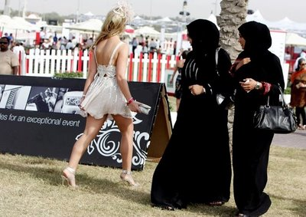
Culture
What is culture?

Slide 5
G-GREASES
G eography
G overnment
R eligion
E conomics
A rt/Architecture
S cience/Technology
E ducation
S ocial Structure

Slide 6
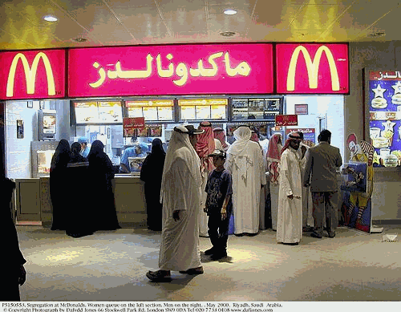
Cultural Diffusion
Spread of culture
Ideas, goods, traditions…
How did it happen?
Migration
Trade
War

Slide 7
Neolithic Revolution
BEFORE
AFTER
Nomads
Hunters & gatherers
1st humans – from Africa
Came to America over land bridge (Russia → Alaska)
Fun Fact: believed in afterlife
Grew food!
Domesticated animals
Permanent settlements (houses)
Social Classes
Technology
Plows, wheel, metal weapons, calendars

Slide 8
How did G-GREASES come into play after the Neolithic Revolution?

Slide 9
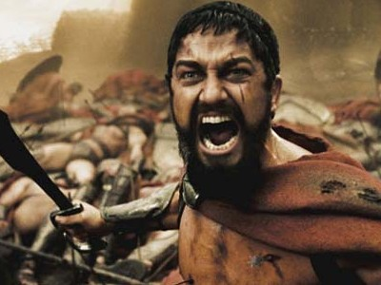
Government
Surplus (extra) food = people lived longer
Increased population, more cities
Government was needed to…
Make sure enough food was grown
Protect cities
Public works (built roads, bridges)

Slide 10
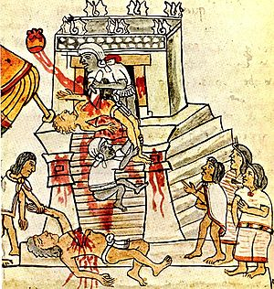
Religion
Polytheism:
Belief in many gods
Prayed for good crops & protection

Slide 11
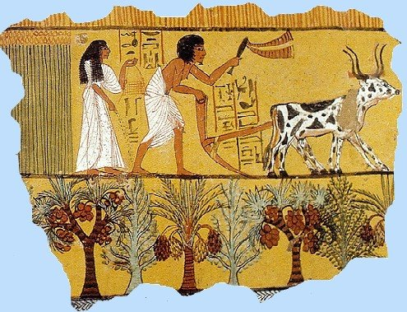
Economy
Farming
Crafts
Pottery, cloth, other goods

Slide 12
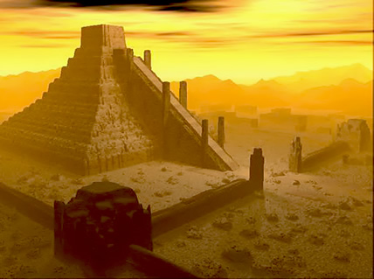
Art & Architecture
Temples & palaces
Symbols of rulers’ power

Slide 13
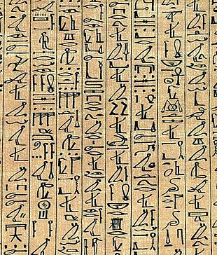
Science/Technology
Writing:
Started in temples
Began as pictures, added more symbols

Slide 14
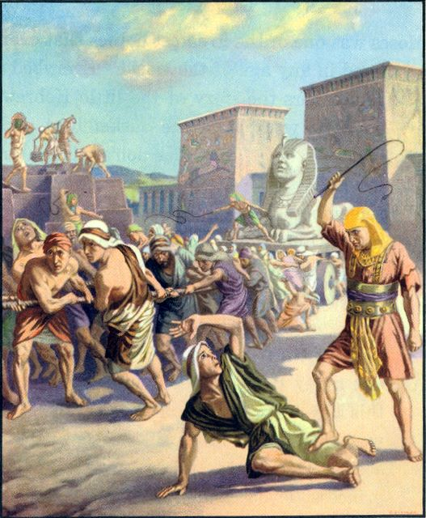
Social Structure
Specialized jobs
Social classes (based on jobs)
Priests
& Nobles
Warriors & Merchants
Slaves & Peasants

Slide 15
Read the Poem “My Name” by Sandra Cisneros
What parts of culture does the author talk about?
What does the author feel about her culture?
Why might she feel that way?
Have you ever felt like this?

Slide 16
My Name
In English my name means hope. In Spanish it means too many letters. It means sadness, it means waiting. It is like the number nine. A muddy color. It is the Mexican records my father plays on Sunday mornings when he is shaving, songs like sobbing.
It was my great-grandmother's name and now it is mine. She was a horse woman too, born like me in the Chinese year of the horse--which is supposed to be bad luck if you're born female-but I think this is a Chinese lie because the Chinese, like the Mexicans, don't like their women strong.
My great-grandmother. I would've liked to have known her, a wild, horse of a woman, so wild she wouldn't marry. Until my great-grandfather threw a sack over her head and carried her off. Just like that, as if she were a fancy chandelier. That's the way he did it.
And the story goes she never forgave him. She looked out the window her whole life, the way so many women sit their sadness on an elbow. I wonder if she made the best with what she got or was she sorry because she couldn't be all the things she wanted to be. Esperanza. I have inherited her name, but I don't want to inherit her place by the window.
At school they say my name funny as if the syllables were made out of tin and hurt the roof of your mouth. But in Spanish my name is made out of a softer something, like silver, not quite as thick as sister's name Magdalena--which is uglier than mine. Magdalena who at least- -can come home and become Nenny. But I am always Esperanza. would like to baptize myself under a new name, a name more like the real me, the one nobody sees. Esperanza as Lisandra or Maritza or Zeze the X. Yes. Something like Zeze the X will do.

