Slide 1
Ancient China
Global 1
Ms. Lyons

Slide 2
Ancient CHINA: 1027 BCE – 220 CE
What was the geography of China like?
How did this affect their view of the world?
  Called themselves the “Middle Kingdom”
  Ethnocentrism

Slide 3
Zhou dynasty

Slide 4
Mandate of Heaven
Divine right: ruler gets power from God

Slide 5
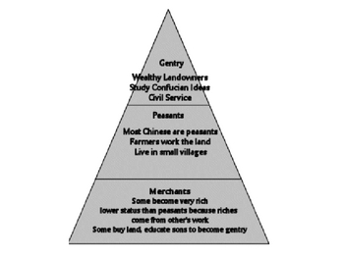
Feudalism
Political, military, & social system based on owning land
D
E
F
E
N
D
L
A
N
D

Slide 6
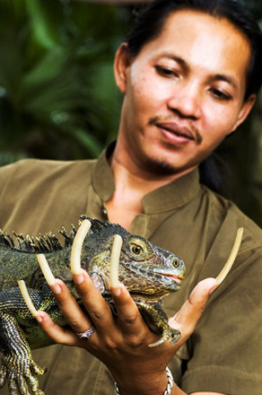
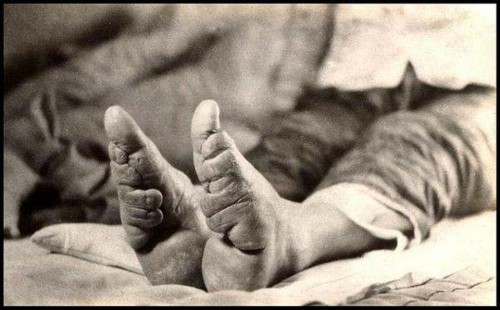
Facts about the Class System
Gentry (rich) grew their fingernails (2 inches!) to show they did not do manual labor
Rich women had to go through “foot binding”
  Crippled women
  Forced to depend on their husbands

Slide 7
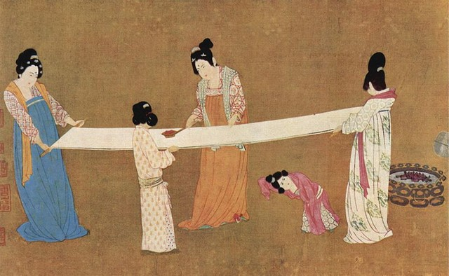
Great Inventors!
Books
Silk
  #1 export

Slide 8
Qin Dynasty

Slide 9
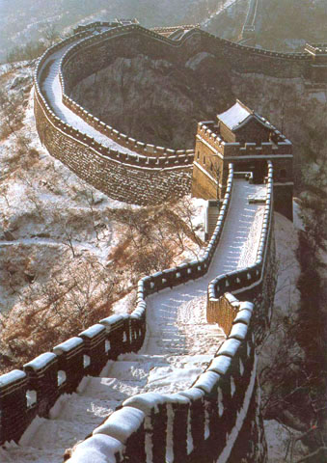
Shi Huangdi
Centralized government
Started building the Great Wall
Legalism
  Harsh rules (like Hammurabi’s Code!)
  Confucianism

Slide 10
Han Dynasty

Slide 11
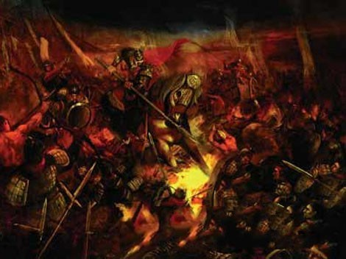
Peasant in charge!
1st emperor was Liu Bang (a peasant)
  Overthrew the harsh Qin
  Relaxed the laws

Slide 12
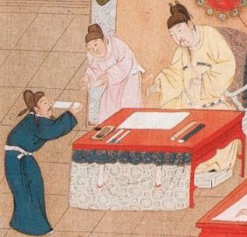
Civil Service Exam
Created by Emperor Wudi
Test men took to get a government job
  Women NOT allowed
Based on Confucianism

Slide 13
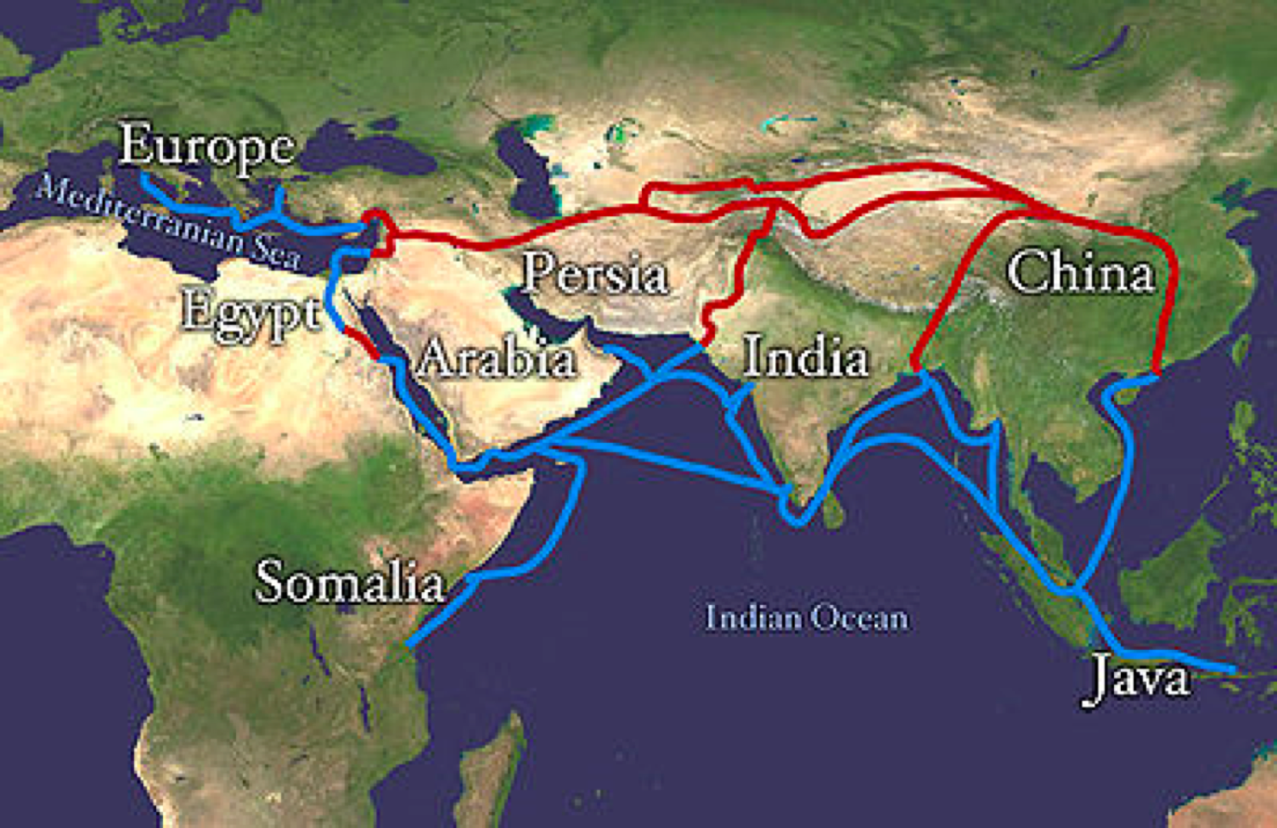
More Inventions!
Made paper from wood
Created acupuncture
Made ceramics
Where did they trade these things?
  SILK ROAD!

Slide 14
Comparing Dynasties

Slide 15
Ancient India

Slide 16
Most Known Dynasties
Maurya
Gupta
Centralized government
Spread Buddhism
Golden Age
  peace & prosperity
Patriarchal
  Men ruled
Inventions!
  concept of “zero”
  decimal system
  Arabic numbers (#s we use today)

Slide 17
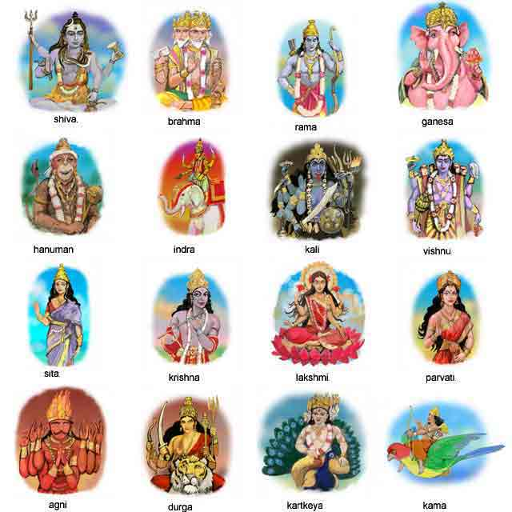
Hinduism
Polytheism

Slide 18
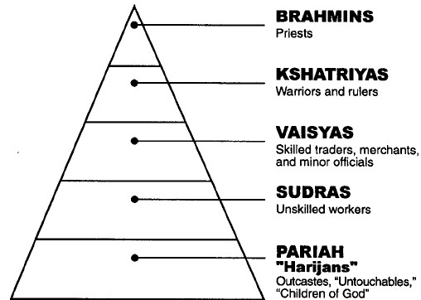
the Caste System
Some say this is linked to religion, some say no
Like a class system, but you can’t ever move up or down

