Slide 1
Great Empires
Global 1
Ms. Lyons

Slide 2
REVIEW: Gupta Empire
Golden Age of India
320 – 550 C.E.
Hinduism, caste system
Monsoons
Inventions!
Concept of “zero”
Decimal system
Arabic numbers (#s we use today)
Plastic surgery
Vaccines

Slide 3
Tang Dynasty
China, 618 – 907 C.E.
INVENTIONS:
Gunpowder
Block printing
Mechanical clocks
Gentry
Peasants
Merchants

Slide 4
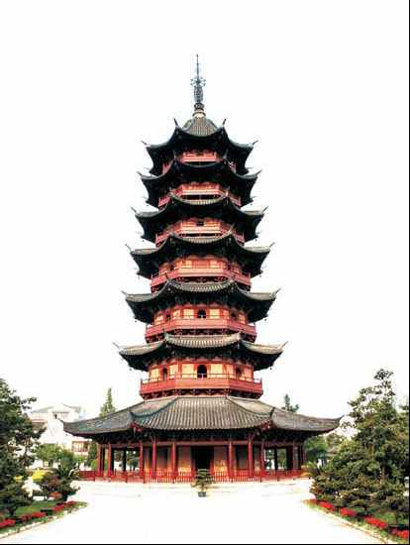
Song Dynasty
China, 960 – 1279 C.E.
Started growing rice!
Art/Architecture:
Porcelain
Calligraphy
Pagodas
Inventions:
Better printing machines (spread ideas)
Spinning wheel (make thread)

Slide 5
What happened to the Roman Empire?
Roman Empire splits in half in 330 C.E.
Eastern half becomes Byzantine Empire
Preserved the Greek & Roman cultures
Capital city = Constantinople
Named after the emperor, Constantine

Slide 6
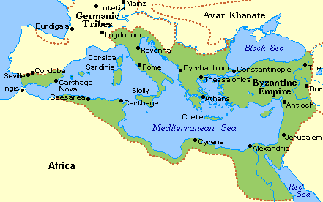
Geography of Byzantine Empire
Peninsula
Constantinople = BIG trading center
Located at the crossroads of Europe & Asia
Cultural diffusion

Slide 7
Justinian’s Code
Justinian was an authoritarian ruler
100% control of government
EXAMPLES:
Innocent until proven guilty
If you kill someone by accident, you’re not guilty.
You need your parent’s permission to get married.
Still used today!
Catholic Church

Slide 8
Religion
VERY RELIGIOUS
Orthodox Christianity
Art – paintings of Jesus, the Bible
Government – Emperor
“Co-ruler” with Jesus
Controlled the church

Slide 9
Russia <3’s Byzantine
Russia borrowed a lot from them!
Byzantine missionaries spread Orthodox Christianity
Russia adapted the Greek alphabet to create Cyrillic (Russia’s written language)
Also borrowed art & literature & architecture

Slide 10
Fall of Byzantine Empire
Lasted for 1,000 years!
Lost their land…
Crusades (religious wars)
Attacks by the Ottoman Empire

