Slide 1
Ancient Greece
Ms. Lyons

Slide 2
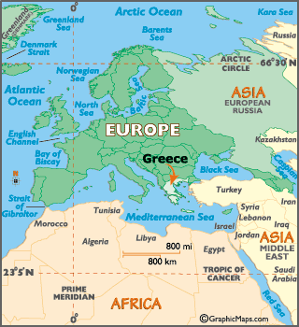
Geography
Continent: Europe
Mountains
Isolated
City-states: Athens, Sparta
Peninsula & small islands
Water = travel & trade

Slide 3
Powerful City-States
ATHENS
SPARTA
Spoke Greek
Direct democracy
All men have a vote
“Book” smarts
Women – not seen outside the home
Spoke Greek
Dual monarchy
Democratic assembly helped make decisions
Warriors
Like the movie 300
Women – more free than in Athens

Slide 4
Athens
Spoke Greek
Direct democracy
All men have a vote
“Book” smarts
2 years of military training
Great navy (close to the sea)
Women – not seen outside the home
Property of husbands
Dracon: wrote strict laws
punishment for all crimes was death
Slaves
owner could kill his slave
Solon – revised gov’t
Outlawed slavery, all people can vote
3 branches of gov’t (checks & balances)

Slide 5
Sparta
Spoke Greek
Dual monarchy
democratic assembly helped make decisions
Warriors
Like the movie 300
Military education since 7 years old
Women – more free than in Athens
Leader (Lykurgos) trained 2 puppies to convince Spartans to focus on military lifestyle…
One for inside, playing
USELESS
One for outside, hunting
SURVIVOR
Weak babies were left on a mountaintop to die

Slide 6
Athens v. Sparta Videos
http://www.youtube.com/watch?NR=1&feature=endscreen&v=gI6sARmxEuc
300: “What is Your Profession?”
http://www.youtube.com/watch?v=uLyW5UYPYYs
Wife Swap: Athens & Sparta

Slide 7
Greek Culture
Geography – peninsula, islands, mountains
Government
Religion
Economics – made goods to trade (close to water)
Art/Architecture
Science/Technology (Math)
Education (Philosophy)
Social Structure – #1 = free men, #2 = women, #3 = slaves

Slide 8
Government
City-states each had their own type of government
At first → Monarchies
Then → Oligarchies
Finally → Democracies

Slide 9
Religion
Polytheistic
Gods lived on Mount Olympus
Greek Pantheon
Gods
Zeus: king of gods, god of sky
Poseidon: god of the sea
Hades: god of the underworld
Ares: god of war
Aphrodite: goddess of love
Athena: goddess of wisdom & war
Demeter: goddess of agriculture
Nike: goddess of victory

Slide 10
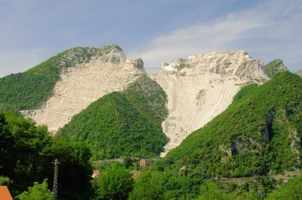
Art
1st full alphabet (with vowels)
Plays
Epics (super long)
Illiad (Greeks attack Troy for 10 years & win with the Trojan Horse)
modern movie = Troy
Aesop’s Fables
Aesop was a slave, but given freedom because he was so smart
Marble statues

Slide 11
Troy
http://www.youtube.com/watch?v=aiyQOumuSN4
Movie trailer
http://www.youtube.com/watch?v=YbiR6IMf5KQ
Trojan Horse scene

Slide 12
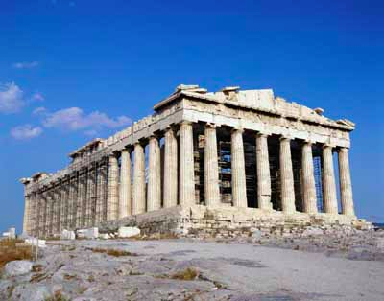
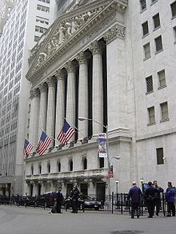
Architecture
Columns

Slide 13
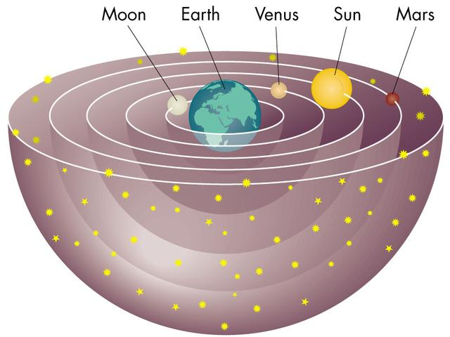
Science
Earth was round!
Geocentrism (Ptolemy)
Hippocrates (doctors take a Hippocratic oath)
“will do no harm”

Slide 14
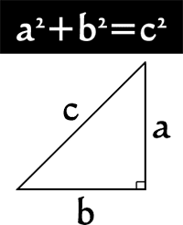
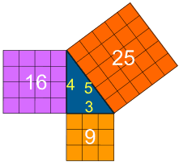
Math
Pythagorean Theorem

Slide 15
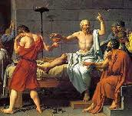
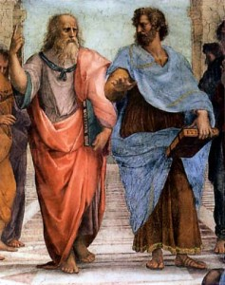
Philosophy
Socrates
Born in Athens
Socratic Method (Q & A)
YOU can figure out the answer, you don’t need someone to tell you
Knowledge = happiness
Government though he was corrupting the youth of Athens
Told him to drink poison & he did it! (because he believed in the law)
Plato
Born in Athens
Soul is separate from the body
Boys AND girls should get a public education
A ruler should have no family or property (just focus on the job)
Aristotle
Lived in Athens for some years
Proved Earth was round
Scientific Method (knowledge comes from observation)

Slide 16
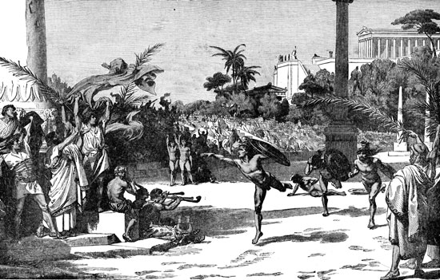
Olympics
Started with 3 city-states to make peace (would not fight during games)
Every 4 years (5 days long)
Women could not participate or even watch

Slide 17
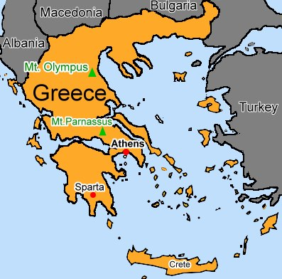
Many Different Leaders
Minoans
King Minos (mythical king, son of gods)
Minos would feed the Minotaur 7 boys & 7 girls from Athens each year.
Ended because: natural disaster (tidal wave/volcano) & invaders
Mycenaeans
Trojan Horse
Mummies in circular tombs
Conquered by invaders
Dorians
Greek Dark Age
Columns
Notes:
Gods sent him a bull to sacrifice, but he kept it – gods punished Minos & caused his wife to fall in love with the bull. They produced a child (monster) ½ bull, ½ human (Minotaur.)

Slide 18
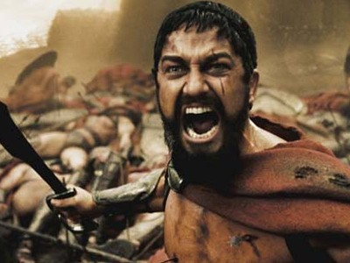
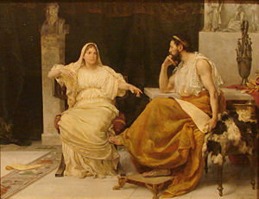
Many Different Leaders
Persian Wars
1: Athens sent a messenger to run to Sparta to ask for help (Marathon)
2: 300 stalled the Persian army & Athens was able to escape
Pericles (Golden Age)
Loved democracy
Partner = Aspasia (very smart woman)
Treated her as an equal & she helped him rule
Peloponnesian Wars (Athens v. Sparta)
Sparta eventually won
Bubonic Plague – disease brought by rats from trade ships
20% of Athens died

Slide 19
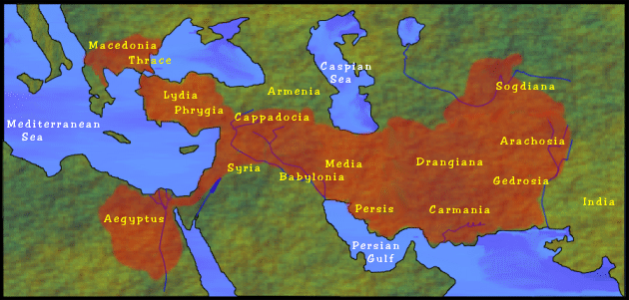
Many Different Leaders
Alexander the Great (336-323 BCE)
Became leader at 20
Conquered Persia, Egypt, India – made leader of Asia by untying the Gordian Knot
Conquered largest empire ever
Cultural diffusion = “Hellenistic culture”
Died of a mysterious illness in Babylon (Mesopotamia)
He was 32
Rome takes over

