Slide 1
African Trading Kingdoms
Global 1
Ms. Lyons

Slide 2
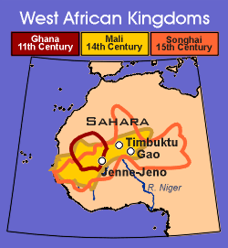
3 Trading Kingdoms of West Africa
Ghana
  (800 CE – 1000 CE)
Mali
  (1200 CE – 1450 CE)
Songhai
  (1450 CE – 1600 CE)

Slide 3
Geography
Africa is the 2nd largest continent in the world!
Niger River
  Compare to: Nile River of Egypt
Savannas (light green on map)
  Grassy plains, hot, good soil
  Most crowded parts of Africa
Trading networks crossed the Sahara
  World’s largest desert

Slide 4
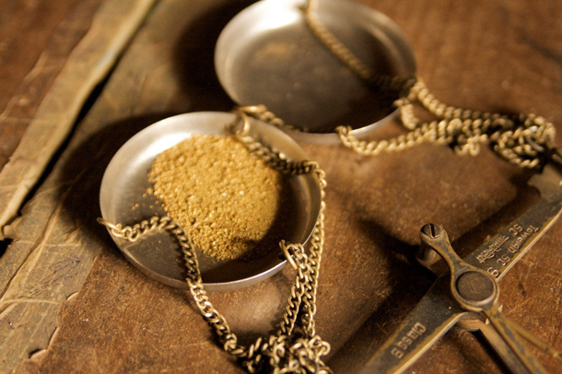
What did they trade?
#1: GOLD
  Kingdoms were rich & strong
  Able to focus on education
Agricultural crops
  Traded with Europe across the Mediterranean
  Led to slave trade

Slide 5
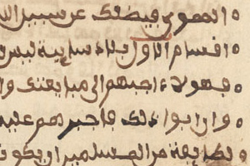
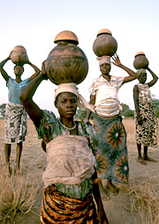
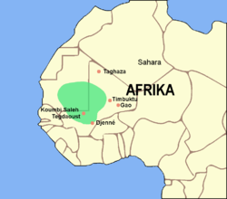
Ghana
Name means: “war chief”
Military technology (from Islam)
Arabic writing
Strong armies
Women had high status

Slide 6
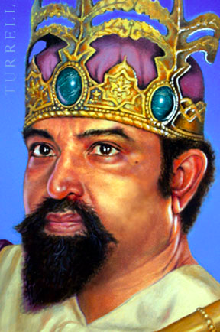
Mali
Name means: “where the king resides”
Strong government
  Women could hold government positions
Mansa Musa: most powerful leader
  Converted to Islam, made pilgrimage to Mecca
  (one of the 5 Pillars)
  Laws based on the Quran
  Increased trade with Islamic Empire
Controlled gold/salt trade
  Mansa Musa created peace & made trade routes safe
Timbuktu is the center of trade, then learning

Slide 7
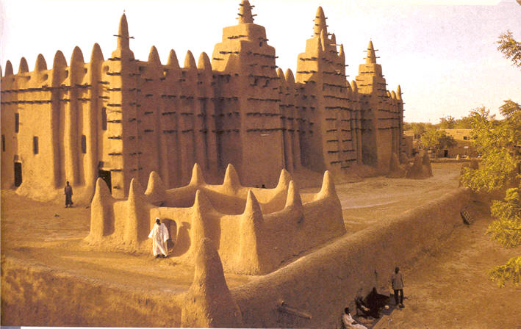
Songhai
Strong army used force to control region
Created an organized government
  Bureaucracy
Slave trade developed
  Merchants became rich & powerful
Timbuktu – center of learning, more universities created

Slide 8

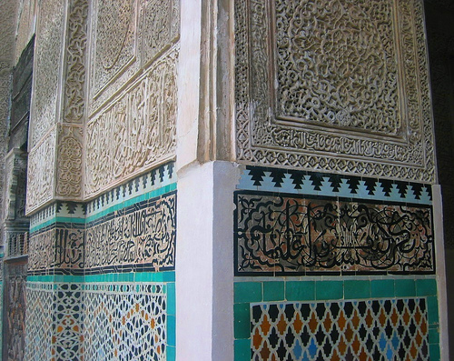
Art & Literature
Religious art (Islam)
Oral histories, folktales

