Slide 1
Comparing Feudal Systems & Crusades
Global 2
Ms. Lyons

Slide 2
NAMETAGS
Fold an index card in half. Write your name on one side.
Stand the card up on the table, name facing out.

Slide 3
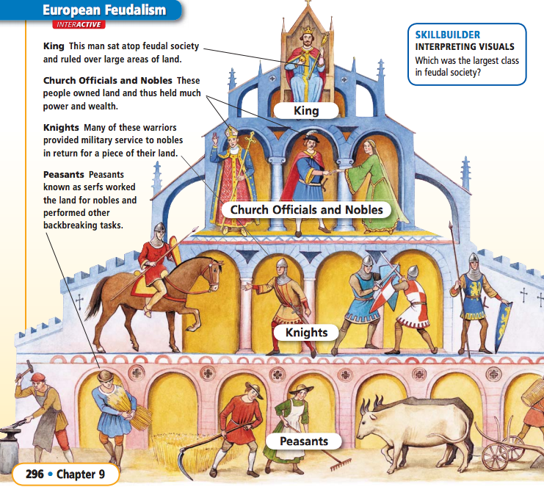

Slide 4
Vocabulary
Manor: noble’s land
Chivalry: code of honor for knights in Europe

Slide 5
To Clarify…
NO centralized gov’t after fall of Roman Empire.
Middle Ages: 500 CE – 1450 CE
Manors were self sufficient, meaning no trade occurred during this time period.
Serfs were not slaves because they could not be bought or sold.

Slide 6
TIMELINE – in partners
Neolithic Revolution
River Valley Civilizations
Mesopotamia (Sumer, Babylon)
Egypt
Indus River Valley
China
Ancient Greece
Ancient Rome
Byzantine Empire
Medieval Europe
Notes:
1 partner researches & 1 partner writes

Slide 7
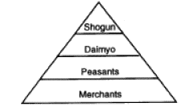
Japanese Feudalism
Government is more centralized in Japan than Europe
Notes:
DY-mee-OH → OR “dime – yo”

Slide 8
Samurai’s Code of Behavior
Bushido
http://www.youtube.com/watch?v=HnbfAC6I4r0
Not so much protecting women BECAUSE women had more rights … some became samurais themselves!

Slide 9
Japanese Feudalism
Stronger central government

Slide 10
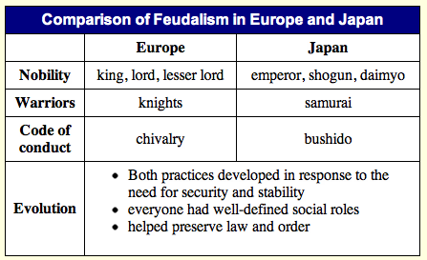
COMPARE/CONTRAST

Slide 11
CRUSADES
TUESDAY

Slide 12
Religion = HUGE.
Only thing that unified Europeans in the Middle Ages = Catholic Church.
Serfs, knights, lords came together to fight for the Catholic Church when they decided to retake the Holy Land (sacred land for Islam, Judaism, and Christianity).
Notes:
Serfs & knights were not truly loyal to their noble/lord. If they could get a better deal somewhere else, they would take it

Slide 13
What motivated the different groups to join the Crusades?
Pope (Urban II) wanted more power
Nobles wanted money & land
Serfs wanted to escape feudalism (freedom!)
All Christians were told their sins would be forgiven if they fought for God
Everyone wanted a chance for travel & excitement

Slide 14
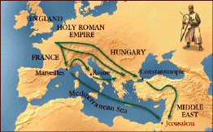
Many Crusades: 1100-1300
Catholic Church fought with Muslims for control of the Holy Land for 200+ years.
#1 city: Jerusalem
Other areas too (Constantinople)
Christians did not win, but many things changed after the Crusades.

Slide 15
What changed after the Crusades?
Increased religious hatred
Christians vs. Muslims
Trade increased, economy grew
Cultural diffusion → Europeans learned a lot
Europe becomes stronger
Pope lost power & nobles gained power
This leads to nation-states & absolute monarchs
Feudalism ended & money system replaced it
Notes:
Most feudal lords were killed, so the ones who lived gained more power.

