Slide 1
Intro to Economic Terms
Economics
Ms. Lyons

Slide 2
Define: Economics
Study of the most efficient use of resources

Slide 3
Goal: Profit
Selling price – cost to make = profit

Slide 4
4 Types of Resources
Land
Labor
Capital (machines, equipment)
Management

Slide 5
Opportunity Cost
When you choose to buy something, what are you giving up?
Example: You have money in the bank. You can buy a nice car OR go to college.
What do you choose?
What is your opportunity cost?

Slide 6
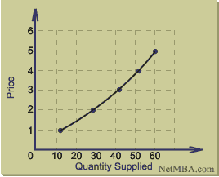
Supply
How much you have to sell
Law of Supply: Companies will produce more if they can sell a lot at a higher price

Slide 7
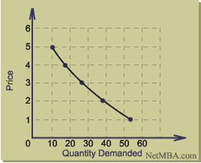
Demand
How much consumers want to buy it
Law of Demand: People will buy more of something at a lower price.

Slide 8
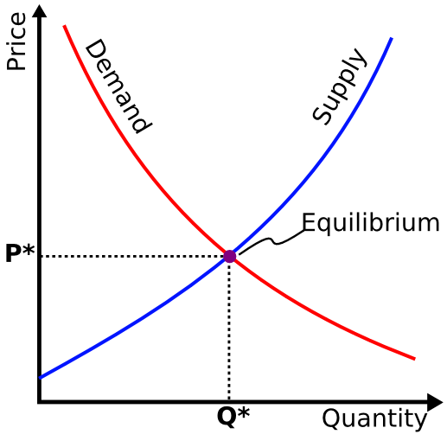
Equilibrium Point
Where supply & demand curves meet

Slide 9
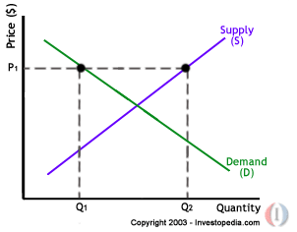
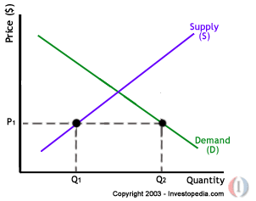
Disequilibrium
Too much supply
Too much demand

Slide 10
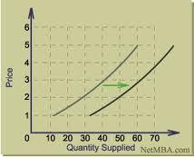
SHIFT in Supply Curve
Quantity supplied changes even though the price remains the same
Causes of Shift:
Cost of resources
Change in price of related goods
Notes:
Sugar becomes less expensive
Businesses can sell MORE soda at same price

Slide 11
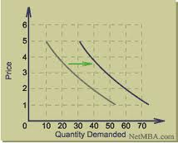
SHIFT in Demand Curve
Quantity demanded changes even though the price remains the same
Causes of Shift:
Changes of disposable income
Changes in taste
Change in price of related goods
Notes:
Example: Grape soda = $1.50
All of a sudden, more demand → same price, but now it’s the only type of soda available

Slide 12
ACTIVITIES/QUESTIONS

Slide 13
How much profit did she make?
The Food Barn sells candy bars at a price of 5 for $1.
Margaret bought $12 worth of candy bars there
She resold half of them at a price of 3 for $1
She resold the other half at a price of 2 for $1.
How much profit did she make (assuming her labor costs are zero)?
Notes:
$13. She bought 60 candy bars for $12. Her revenue on the 30 candy bars she sold at 3/$1 is $10; her revenue on the 30 she sold at 2/$1 is $15. Total revenue less total cost is $25 - $12, or $13.

Slide 14
How do you do divide cake or flip coins with 3 people (instead of 2)?
If two people are splitting a piece of cake, then the “I divide, you decide” rule ensures that the cake cutter will try to cut equal portions (since the other person chooses first).
But what do you do if three people are splitting a piece of cake?
Also, how do you flip a coin if three people are trying to decide who gets to do something?
Notes:
The “I divide, you decide” rule works on three-way splits, too. Just have one person cut the cake into three equal slices, but let the other two choose first. Since the cake cutter gets the third largest slice, he or she will take pains to cut the cake into exactly equal portions. If you flip a coin twice, there are four possible outcomes: HH, HT, TT, and TH. If you’re flipping a coin to pick a winner among three people, have each of them pick one of these outcomes (one will be left over). Then flip twice. If nobody wins, then flip twice more.

Slide 15
Why is the price so high in some places, but low in others?
Notes:
DEMAND?

