Slide 1
Intro to Economics Activity
Economics
Ms. Lyons

Slide 2
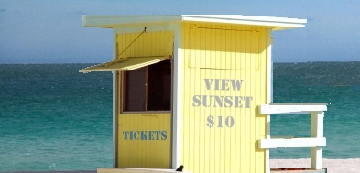
What’s Wrong with this Picture?
Notes:
Concept: Public good. What's wrong with this picture? Sunsets are a non-excludable good, in that non-payers can't be prevented from enjoying them. Other examples of non-excludable goods are national defense, fireworks, and lighthouses. Private firms tend to underproduce non-excludable goods because customers have little incentive to pay for them. Public goods are both non-excludable and non-rival.

Slide 3
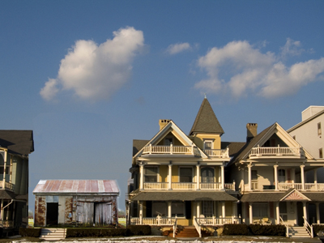
What’s Wrong with this Picture?
Notes:
Concept: Opportunity cost What's wrong with this picture? Most of the homes on this lakefront are expensive and built close to each other, so it's likely that the lakefront lots are highly valued. This, in turn, suggests that the opportunity cost of living in the shack is high. We rarely see shacks on expensive lots because the owners usually conclude that they'd do better by selling their property and buying a nicer house on a less desirable lot. (Click on the photo to download a high resolution version of this image.)

Slide 4
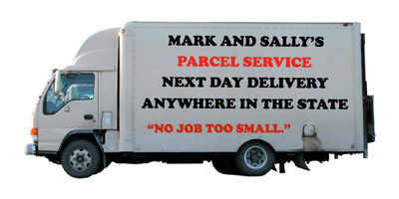
What’s Wrong with this Picture?
Notes:
Concept: Economies of scale What's wrong with this picture? It's hard to imagine that Mark and Sally will make a profit with their business. Suppose a customer asks them to deliver a small package to a city 200 miles away. Unless they have many other packages going to the same city, they'd have to charge a lot just to cover their variable costs--labor, gas, and depreciation. They wouldn't be able to compete against companies like UPS and FedEx, which can keep their costs down by handling a huge volume of parcels. (Click on the image to download a high resolution version of this image.)

Slide 5
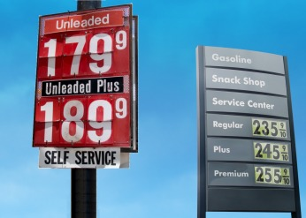
What’s Wrong with this Picture?
Notes:
Concepts: Equilibrium, law of one price. What's wrong with this picture? The more expensive gas station probably won't get many customers and will be forced to lower its prices. The Law of One Price says that identical goods in efficient markets must have only one price in equilibrium. (Note: Click on the picture to download a high resolution version of the image.)

Slide 6
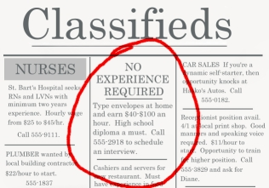
What’s Wrong with this Picture?
Notes:
Concept: Equilibrium. What's wrong with this picture? This is too good to be true. Since a business can get all the inexperienced home typists it wants at a much lower wage, it makes no sense for it to offer $40-$100 an hour. (Note: Click on the picture to download a high resolution version of the image.)

Slide 7
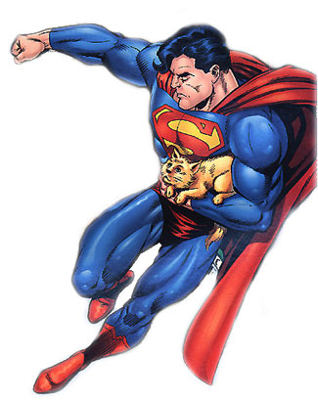
What’s Wrong with this Picture?
Notes:
Concept: Opportunity cost, comparative advantage What's wrong with this picture? It's nice of Superman to rescue a kitten, but has he considered the opportunity cost of doing so? Rescuing kittens is so easy that children often do it. With all the accidents, crimes, and natural disasters that occur in the world, surely he could spend his time more productively. The concept of comparative advantage suggests that Superman should focus on tasks that others can't do well, like stopping runaway trains or transporting nuclear weapons into deep space so they can detonate safely.

Slide 8

What’s Wrong with this Picture?
Notes:
Concepts: elasticity, price discrimination What's wrong with this picture? You'd think that movie theaters would charge students and children more than adults, since kids are more likely to spill popcorn and make noise. But theater owners know they can earn more revenue by charging students and children less. The reason is that kids are more price sensitive (in economic terms, they have a higher price elasticity of demand), and therefore less likely to come to the movies if the prices are high. The practice of charging price sensitive customers less is called price discrimination.

Slide 9
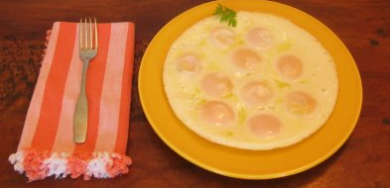
What’s Wrong with this Picture?
Notes:
Concept: Law of diminishing returns What's wrong with this picture? It's not just the calories--a Big Mac with supersized fries has more. The law of diminishing marginal utility says that as a person increases consumption of a good, holding consumption of other goods constant, the marginal utility he or she gets from each additional unit of that good declines. This suggests that the marginal utility of the second egg will be smaller than that of the first, and the marginal utility of the third will be smaller still. For most people, the marginal utility of the tenth egg would likely be negative. (Note: Click on the picture to download a high resolution version of the image.)

Slide 10
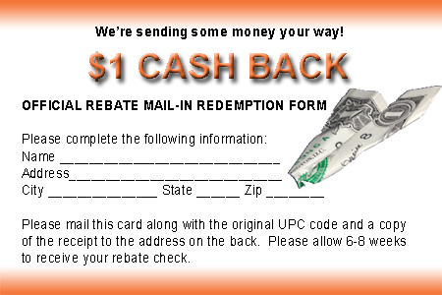
What’s Wrong with this Picture?
Notes:
Concept: Opportunity cost What's wrong with this picture? The opportunity cost of getting the rebate includes the cost of the stamp and envelope, plus the time it takes to fill out the form, cut out the UPC code, get a copy of the receipt, address an envelope, and mail it off. For most of us, that cost is greater than $1. (Click on the picture to download a high resolution version of the image.)

Slide 11
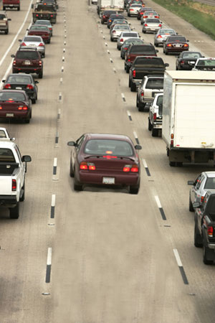
What’s Wrong with this Picture?
Notes:
Concepts: incentives, equilibrium, efficiency What's wrong with this picture? Equilibrium is defined as a state in which there is no tendency to change. In economics, this usually occurs when everyone is doing the best he or she can. The lanes in this picture aren't in equilibrium because some drivers could do better by moving into the relatively empty lane. Note that achieving equilibrium -- with cars distributed more evenly among the lanes -- would promote efficiency in that it would help all drivers reach their destinations faster. In a similar way, the efforts of producers and consumers to promote their interests can result in an efficient market outcome.

Slide 12
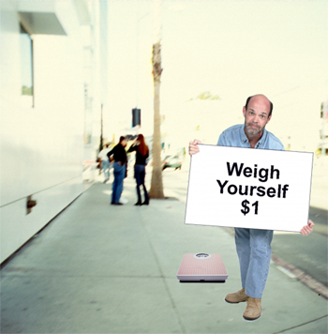
What’s Wrong with this Picture?
Notes:
Concepts: opportunity cost, substitutes, demand What's wrong with this picture? People offer this service in less developed countries, but they don't in richer countries. Most Americans have scales at home (a substitute for public scales), so the demand for this service is small. It's unlikely that this man would get enough customers to cover the opportunity cost of his time. (Note: Click on the picture to download a high resolution version of the image.)

